Slide 1






Development of an Ultra High dynamic range Third Order Cross-correlator for 10⁻¹⁴ Ultra High Contrast Laser
PM Paul¹, L.Vigroux¹, L.Canova², F.Falcoz¹, P.Leroy¹,
P.Monot³, G. Riboulet¹
LOA-ENSTA

Slide 2
OUTLINE
Introduction : why high contrast for PW
Class laser?
Generating high energy (>1 mJ) XPW
Results in double CPA configuration
How to measure very High Contrast ?
Conclusions
Notes:
A short outline of my talk
I will first make a brief introduction on why high contrast is needed for high energy laser
I will then present the results we have obtained on high energy XPW
I will show results when this XPW is integrated in a double CPA scheme
Then I will explain how we have measured this very high contrats

Slide 3
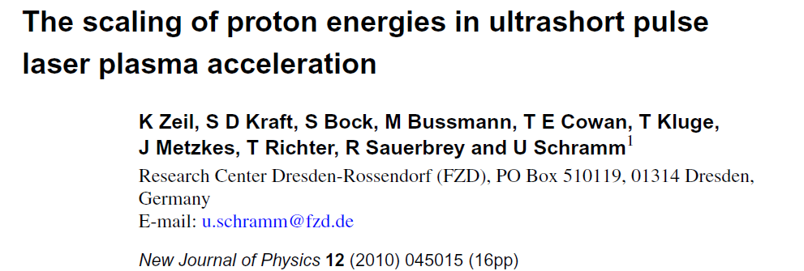
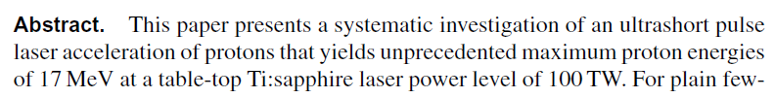
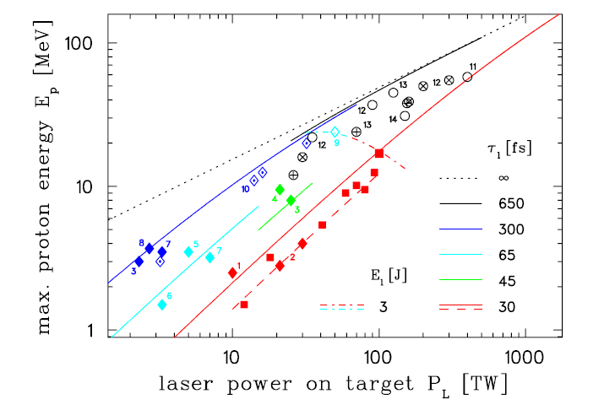
150 TW DRACO
FZD, Germany
17 MeV
Obtained with PULSAR from AMPLITUDE TECHNOLOGIES
The contrast ratio on
the ASE was 10¹⁰
Notes:
One of the main application of high energy laser is the acceleration of particles like protons for example.
Recent experiments have demonstrated high energy protons (around 17MeV) obtained from a table top 100 TW laser from amplitude technologies

Slide 4
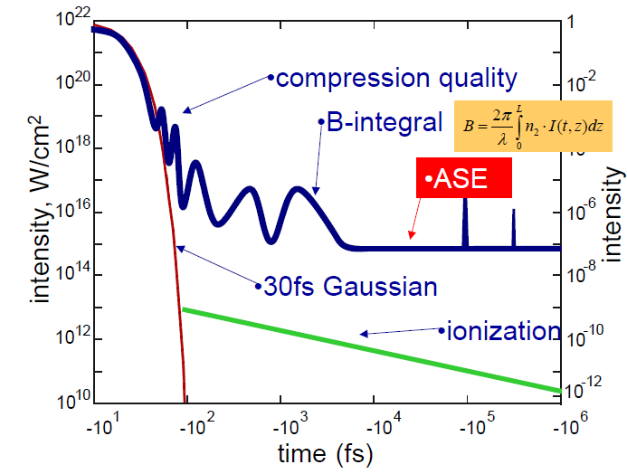
For PW class laser, a contrast better than 10¹² is required
I_{ASE} has to be < 10¹⁰ W/cm²
The ASE intensity is enough to generate a pre-plasma. The main Pulse will interact with an expanding plasma.
time
Notes:
When we focus a beam on a solid target the contrast between the main pulse and the ASE is very important.
The red and green curves represent the desired shape of the pulse on the target.
If the level of the ASE is above 1010 W/cm² it can create a preplasma that destroy the target
That means that for a PW class laser the contrast has to be better than 10 12

Slide 5
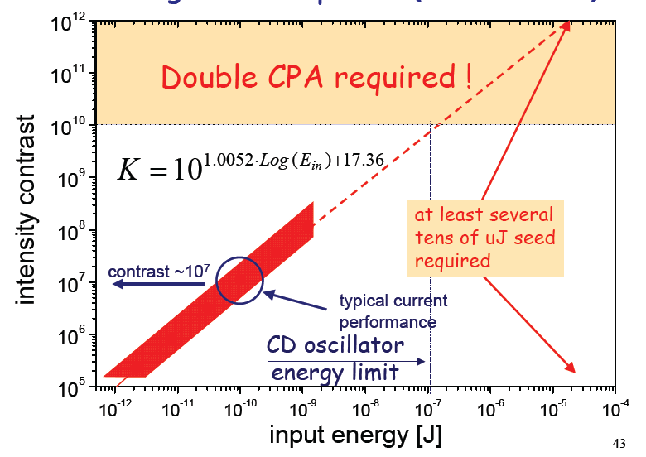
Contrast Enhancement in PW Class laser Systems
M. Kalashnikov, Modern Problems of Laser Physics (2006)
Notes:
To obtain contrast better than 10-12, several tens of microjoule has to be seeded, this requires a double CPA scheme

Slide 6
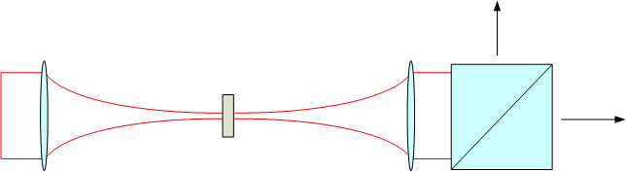
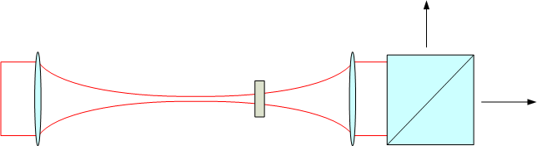
XPW Current Limitations
XPW is the non linear filter that will be used to reach the contrast
IR
χ⁽³⁾
XPW
However :
Input Energy is limited to ≈ 200 μJ
η = 10-30 %
Available seed energy for the second CPA is 20-70 μJ
For efficient Contrast Cleaning, Higher XPW energy must be obtained

Slide 7
Demonstration of high energy XPW
The first CPA is based on a standard system pumped at 10 Hz
CPA Laser system
Oscillator
CW Pump Laser
Stretcher+
Dazzler
RGA+Mazzler
MPA
10 Hz Pump Laser
XPW Module
Compressor

Slide 8
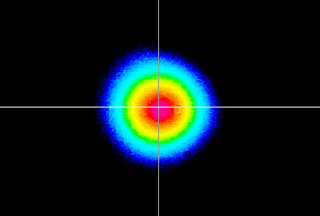
Laser system characterization

Slide 9
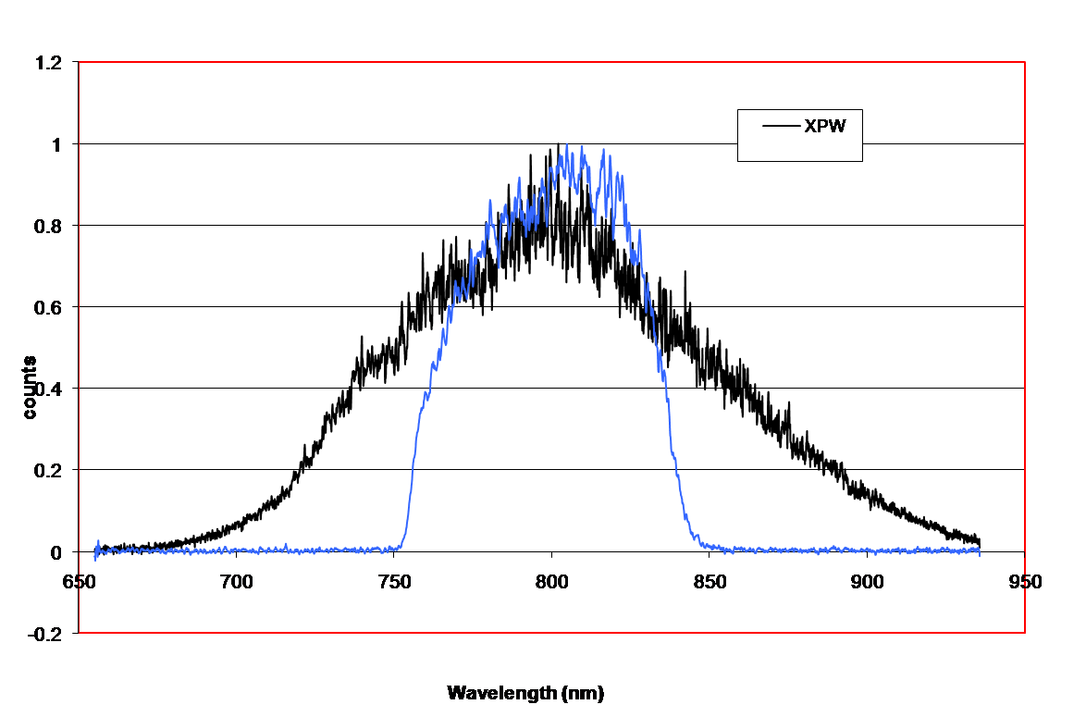
XPW characterization
Fundamental spectrum 80 nm FWHM
XPW spectrum 130 nm FWHM
XPW Spectrum is 1.6 times broader than the Fundamental input spectrum

Slide 10
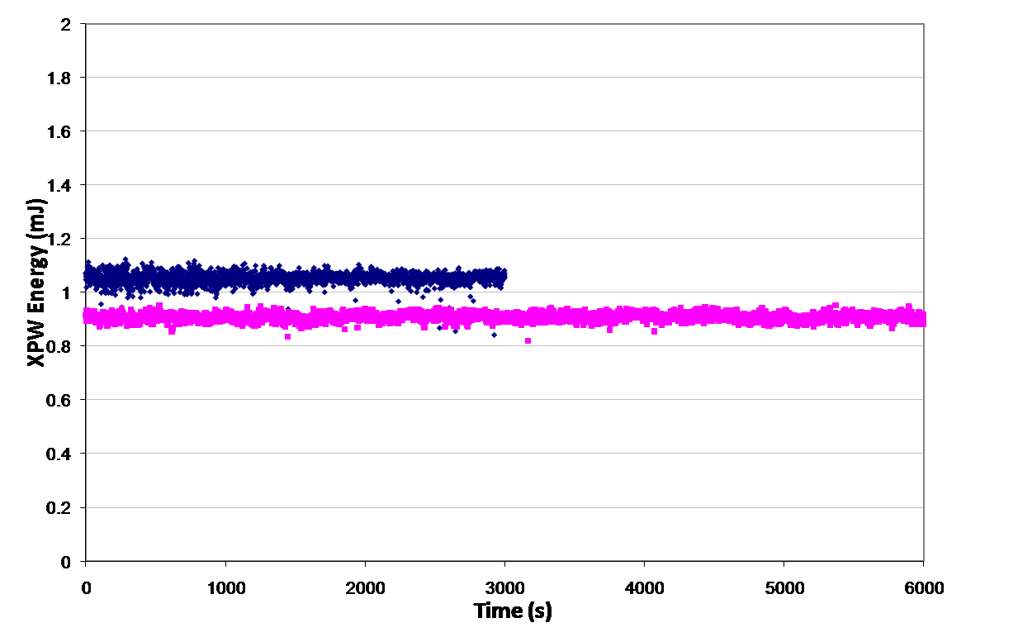
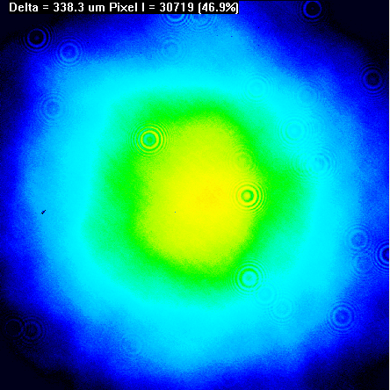
XPW characterization
Up to 1.1 mJ is obtained
Notes:
Jean-Paul avait promis une bouteille de champagne au premier qui ferait plus d’1 mJ d’XPW, on attend encore…

Slide 11
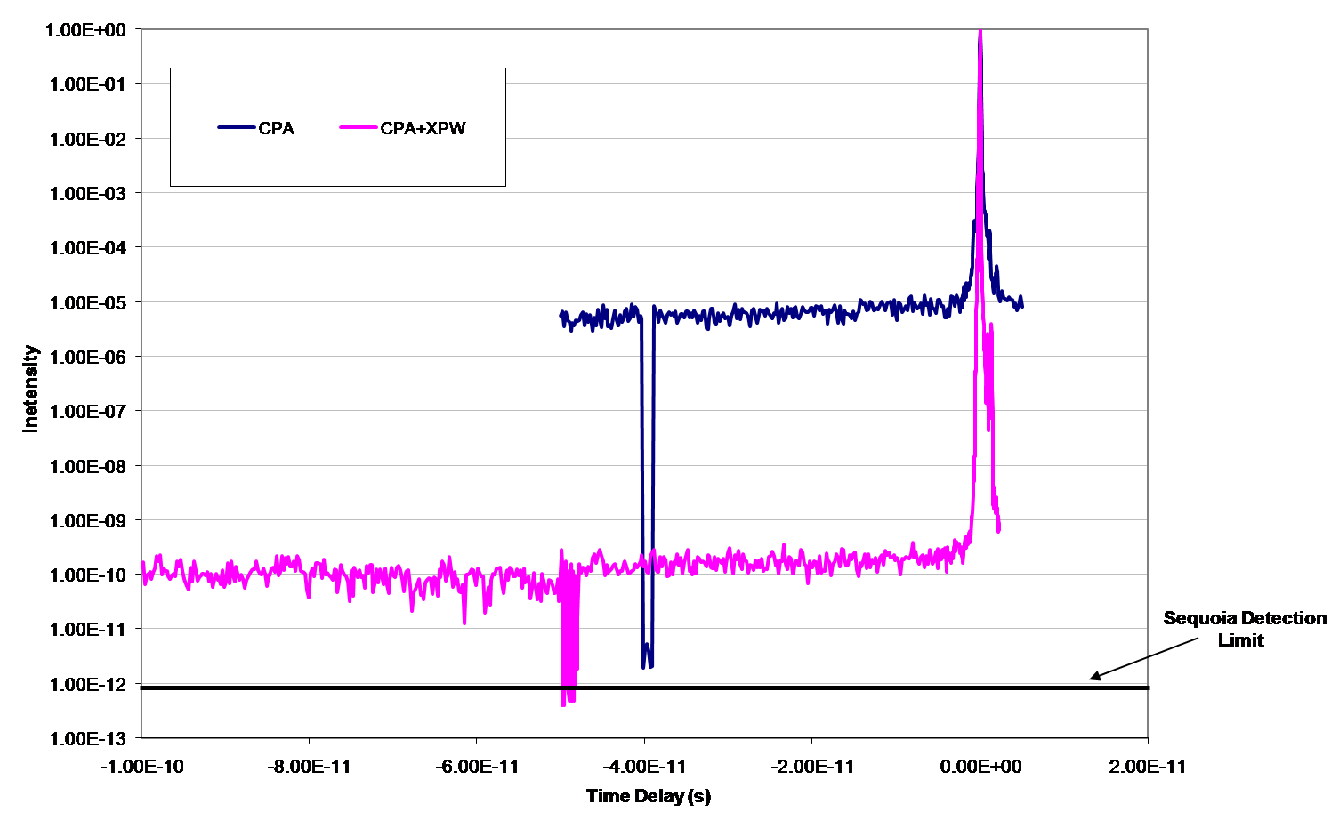
XPW characterization
The Temporal contrast
Is cleaned by 5 orders
Of magnitude

Slide 12
Double CPA scheme
As the contrast of 10⁵ is not enough, the first CPA has been modified to include a saturable aborber
CPA Laser system
Oscillator
CW Pump Laser
Pre-Amp+
SA
Stretcher+
Dazzler
XPW Module
RGA+Mazzler
MPA
10 Hz Pump Laser
CPA Laser system
Compressor
Output from the second CPA:
4 mJ/pulse at 10 Hz
50 nm bandwidth
Notes:
To obtain very high contrast, the front must be high contrast 10-11 instead of 10-5. the saturable cleaning technique is used in the front end

Slide 13
10⁻¹⁴ Contrast has been achieved
Detection limit

Slide 14
How to Measure Ultra High Contrast ?
Detection limit of a standard SEQUOIA : 10¹²
Goal: Increase of the dynamic range of the Sequoia
Decrease of minimum measurable signal by reducing the equivalent noise power
  Hardware (Optics and Electronics)
Increase the input power/ intensity ⇒Handling the 2ω saturation, modulating the ω arm.
Increase the intensity on the THG crystal for weak signals

Slide 15
Variable attenuator
Delta function=frequency doubling
Signal=3ω
Frequency doubling
Frequency mixing
Detector
Acquisition
Variable delay line
2w=delta fonction
Density filters have been moved from the input beam to the infrared path in the sequoia => possible to increase the energy on the 2w arm
How does the 2ω saturation affects the measured temporal profile ?

Slide 16
SHG Saturation Energy
Two points must be verified :
- What is the value of the 2ω saturation energy ?
- What is the impact onto the temporal profile ?
0.25 mJ
0.5
1.15
3
5 mJ
Saturation Energy≈1 mJ
Notes:
The measurement on rigth hand side are not corrected for the density filters attenuation, that’s why there is 3 orders of magnitude difference bewteen max and min values of the energy.

Slide 17
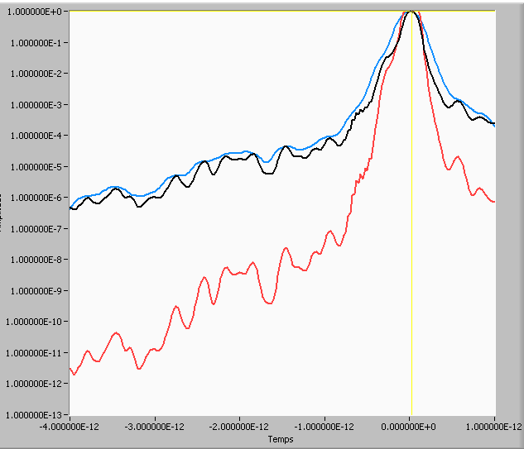
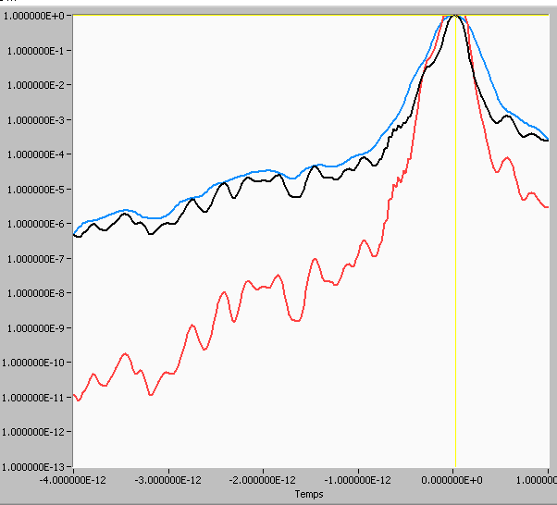
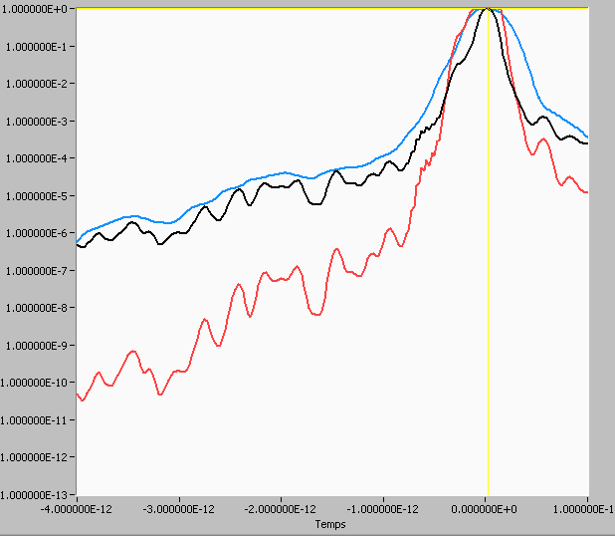
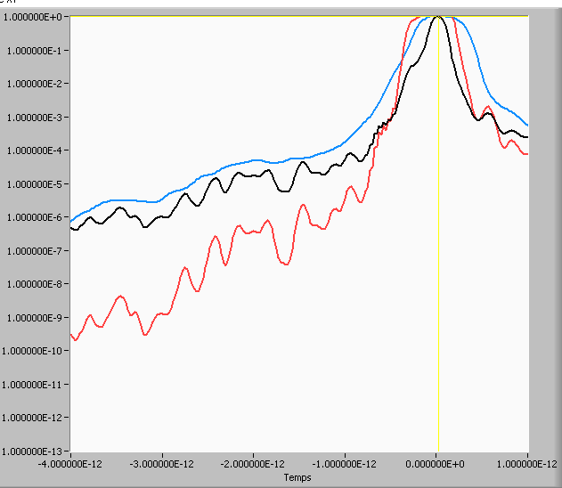
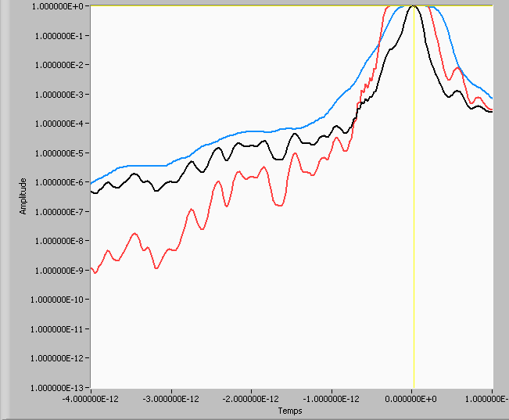
5 mJ
10 mJ
20 mJ
Reference profile 0.25mJ
2ω
Cross correlation
Pulse broadening
Starts at 20 mJ
50 mJ
100 mJ

Slide 18
Simulation 5 mJ
Mesuré 5 mJ
Référence 0.25 mJ
Simulations and measurements show that saturation of the SHG does not affect the temporal profile for energy below 20 mJ
=> Around 2 orders of magnitude better should be possible.

Slide 19
First Measurements
The Incoherent part is slightly driven into saturation
Reconnect here
unsaturated
Saturated part
Notes:
About 2 orders increase of the signal in the incoherent part, then reconstruction of the whole curve

Slide 20
Contrast ratio measurement

Slide 21
Conclusions
We have demonstrated the possibility to generate high energy XPW radiation up to 1 mJ
XPW is a good candidate for non linear filtering to obtain short pulses with very High contrast (10⁻¹⁴)
Measurement with 14 orders dynamic are possible but improvements in high dynamic range tools still need to be done

