Slide 1
Stretcher and compressor design for the Apollon10P ILE laser facility
Loïc Le Gat* ^{1,2} and Catherine Le Blanc ²
¹ Institut de la Lumière Extrême, CNRS, Ecole Polytechnique, ENSTA Paris Tech, Institut d’Optique, Univ Paris-Sud, Palaiseau Cedex, France
² Laboratoire pour l’Utilisation des Lasers Intenses - Ecole Polytechnique, 91128 Palaiseau, France
*Loic.legat@polytechnique.edu
ICUIL 2010 Conference
September 26 - October 1
Watkins Glen, New York

Slide 2
Outline
Introduction to the ILE facility
Stretcher design study
Compressor design study
Spectral Phase Management
Conclusion and perspective

Slide 3
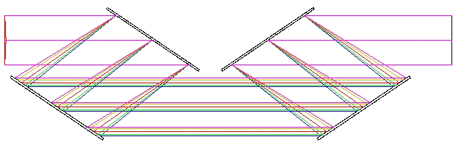
Introduction to the ILE facility
Stretcher
Amplifiers
KHz Ti:Sa
25 fs @ 800 nm
1.5 mJ
Spectral broadening
< 10 fs @ 800 nm
100 µJ, kHz
ϕ 10
Ampli 0
2J /1Hz
Ampli 1
« LASERIX »
50J /0.1Hz
Ampli 2
600J -1shot/mn
OPCPA
LBO/BBO
“10 fs“ (80 nm FWHM)
@ 800nm
100 mJ
synchronized
Front End
Yb:KYW
Diode pumped
2 ns, 2 mJ
@ 1030 nm
Amplis Yb:KGW
Yb:YAG
Diode pumped
2 J @ 1030 nm
>10Hz
Compression
and SHG
1 à 100 ps
1 J @ 515 nm
>10 Hz
Nd YAG
6J/1Hz
Nd Glass
100J/0.1Hz
Nd Glass
1.5KJ – 1tr/mn
ϕ 180 mm
250J
“15 fs” (65 nm FWHM)
Compressor
150J / 15 fs
@1shot/mn
10 PW
G4
G1
ϕ 400 mm
G3
G2
Grating size : 910 x 455 mm
Notes:
3

Slide 4
Stretcher design study
Stretcher specifications:
Spectral bandwidth acceptance: 700-900 nm
Only reflective optics can be used
High transmission efficiency
Low temporal and spatial aberrations are required
High stretching ratio = 13 ps/nm
The size of the optics is a constraint

Slide 5
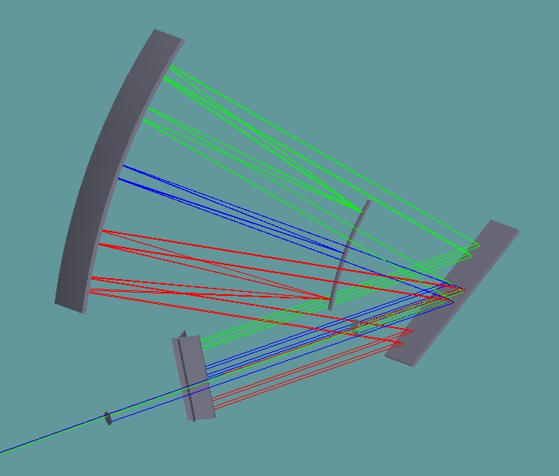
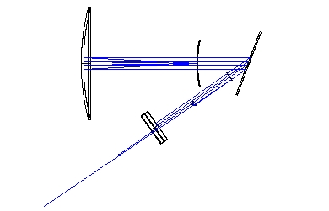
Single grating stretcher: scheme
Distance grating – center of curvature linked to the stretching ratio.
Roof mirror for a second pass.
Top view
1000 mm
Convexe mirror R500
Grating
Concave mirror R1000
Center of curvature
500 mm
275 mm
x
Roof mirrors
Z (optical axis)
y
800 nm beam

Slide 6

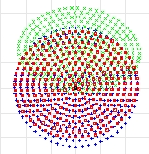
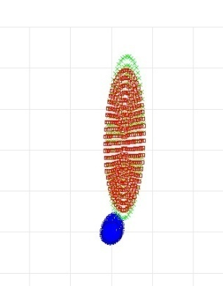
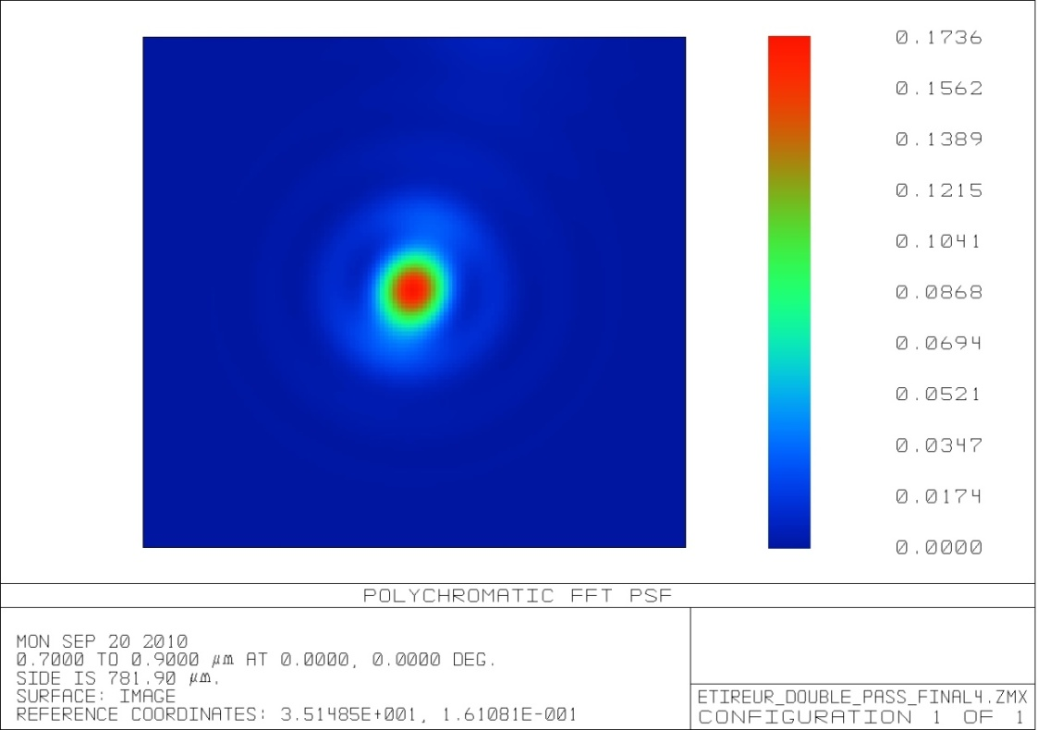
Spatial characteristics of the output beam:
Spot diagram and aberrations
Strehl ratio = 0.17
12.8 mm
3.4 mm
Airy disk = 200 µm
Spot diagram at the single grating stretcher output
Spot diagram at the stretcher output, after a perfect focal lens (f1000)
x
Point Spread Function
y
Blue = 800 nm
Green = 700 nm
Red = 900 nm

Slide 7

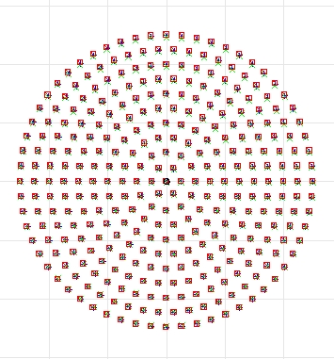
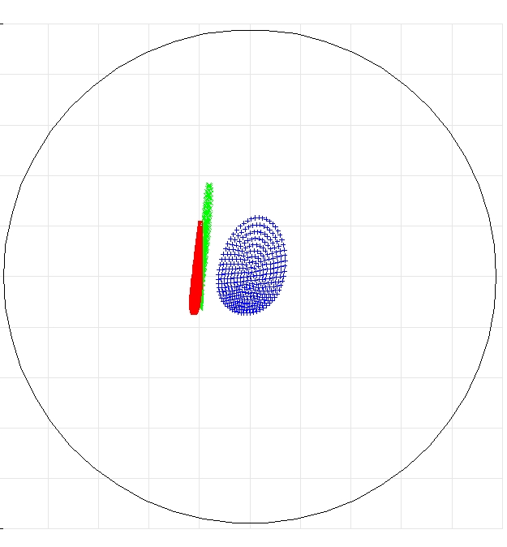
Increasing the radii in the afocal system to reduce aberrations
= increasing the ratio:
For a R2000 concave mirror and a R1000 convex one:
Airy disk
10 mm
200 µm
Blue = 800 nm
Green = 700 nm
Red = 900 nm
x
Spot diagram at the output of the stretcher
y
Spot diagram after a perfect focal lens (f1000)
Aberrations 50 times lower
Concave mirror is a Φ800 mm (instead of Φ400 for a R1000) !!

Slide 8
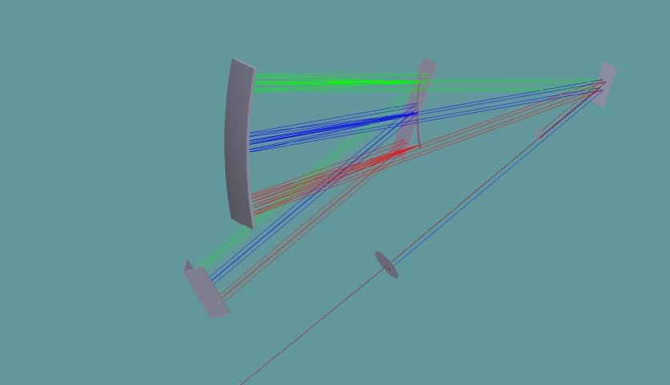
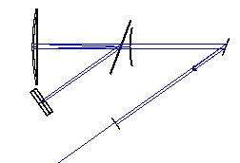
Two gratings stretcher: scheme
One grating is placed on the center of curvature.
Stretching ratio related to the distance between the 2 gratings
1000 mm
Grating 1
487mm
Center of curvature
500 mm
Grating 2
Roof mirror 2
Roof mirror 1
x
Z (optical axis)
y

Slide 9

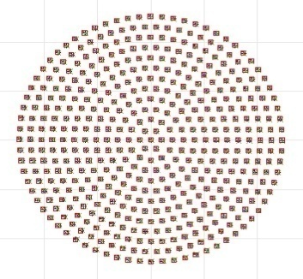
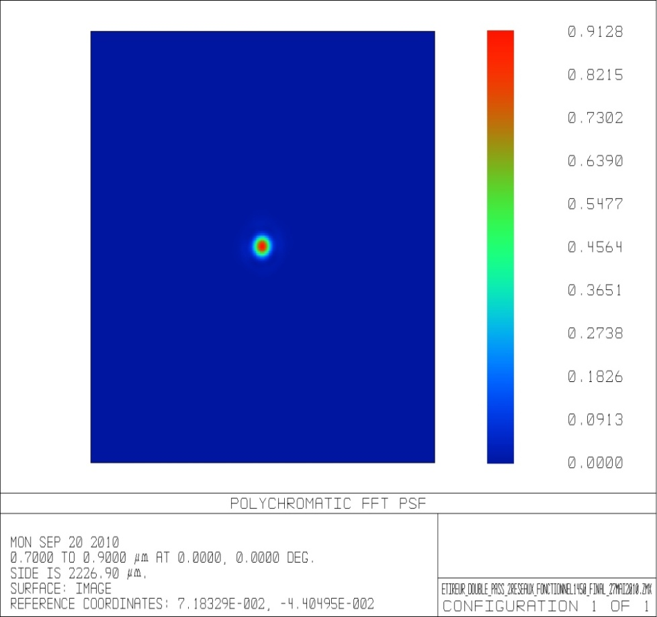
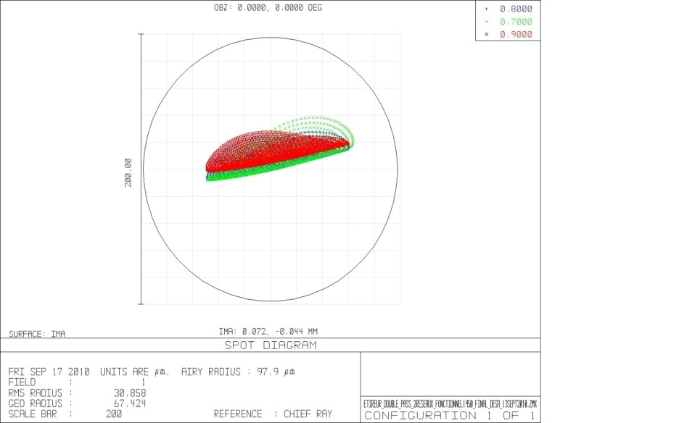
Spatial characteristics of the output beam:
Spot diagram and aberrations
Strehl ratio = 0.91
10 mm
Spot diagram at the output of the two gratings stretcher
x
y
Airy disk : Ø200 µm
Point Spread Function
Spot diagram after a perfect focal lens (f1000)
Blue = 800 nm
Green = 700 nm
Red = 900 nm

Slide 10
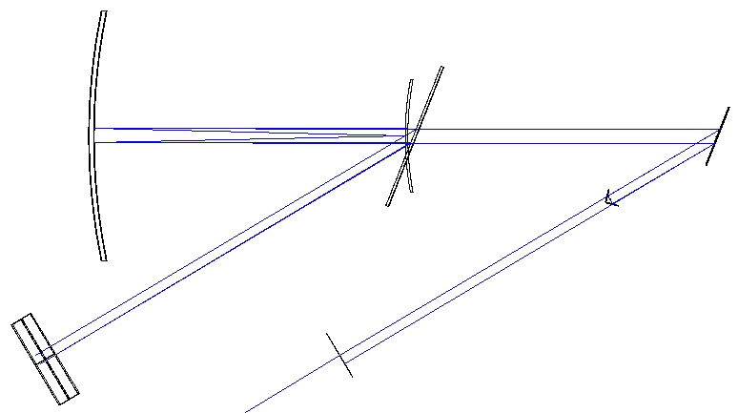
Conclusion
A two gratings design reduces spatial aberrations
Alignment procedure is more complicated
Vertical chirp improved by replacing the second-pass roof mirror by a corner cube
Concave mirror
Convex mirror
200 mm
Grating 1
400 mm
70 mm
280 mm
Grating 2
Roof mirror
200 mm

Slide 11
Compressor design
Compressor specifications:
Pulse to recompress:
  250 J of input energy, 15 fs output, 65 nm @800 nm (stretched with 13 ps/mm)
Gold coating: max fluence on the grating = 150 mJ/cm²
Beam size Φ400 mm
4 ultra-wide monolithic gratings (Livermore gratings 910x455 mm²)

Slide 12
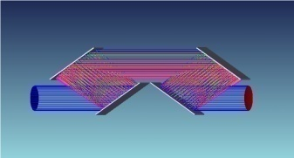
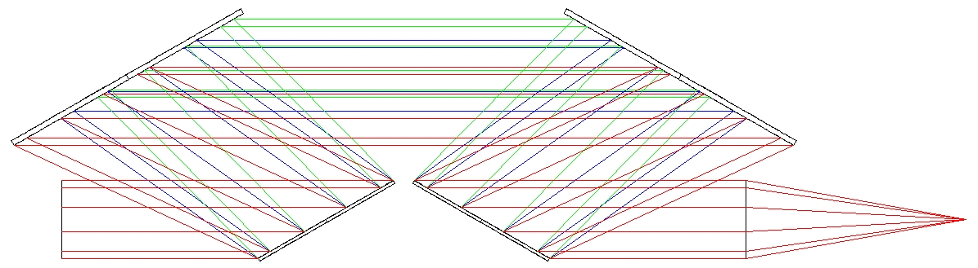
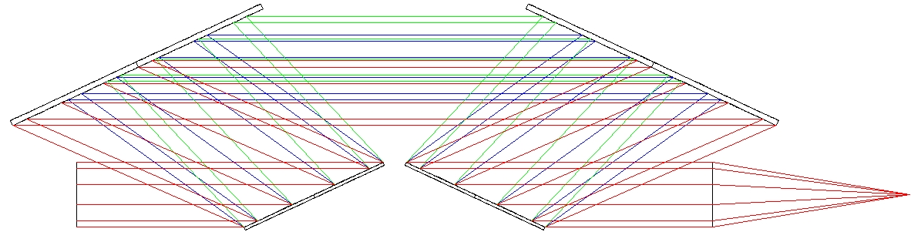
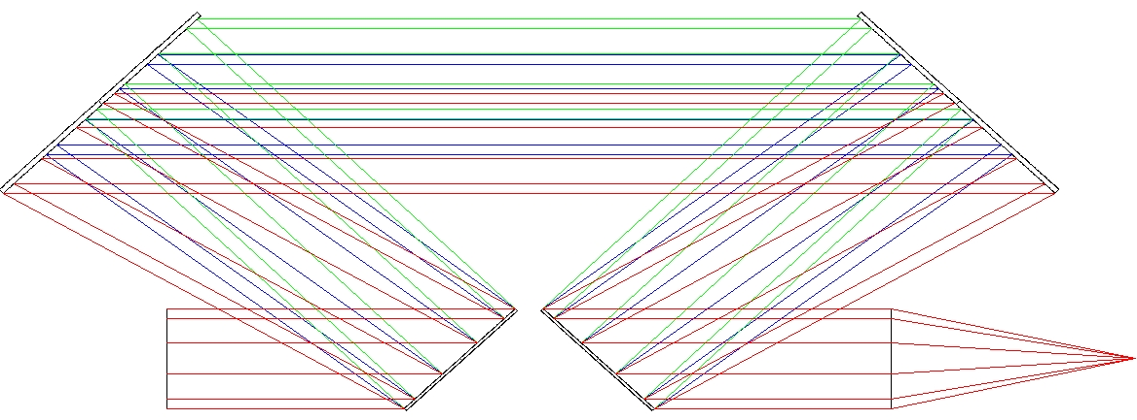
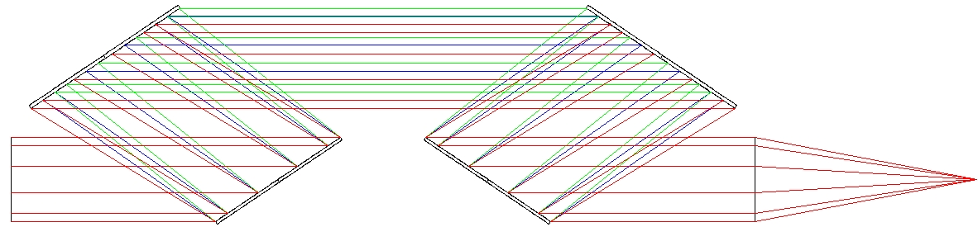
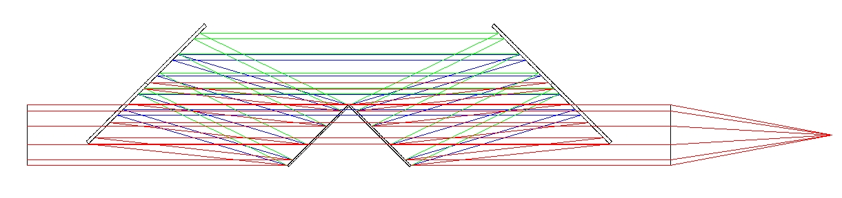
Several cases studied
1200 mm
1600 gv/mm
1200 mm
1400 mm
1740 gv/mm
1400 mm
15° and 35° of deviation (difference angle of incidence – diffracted angle)
Densities studied: 1200, 1480, 1600 and 1740 gv/mm
15° leads to geometrical issues
1200 gv/mm
1090 mm
1090 mm
1200 gv/mm
910 mm
910 mm
1480 gv/mm
1480 gv/mm
y
Best solution !!
x
Z (optical axis)

Slide 13
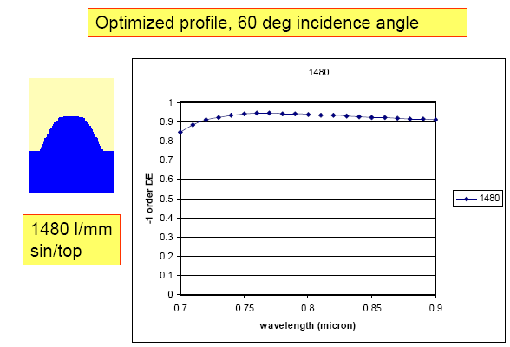
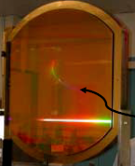
Livermore gold gratings specifications
65 % of transmission expected for the 4 gratings

Slide 14
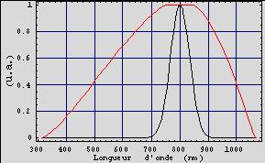
4 gratings compressor: calculation of the transmited spectrum for a 400mm diameter beam size
Input spectrum
Compressor spectral transmission
FWHM spectrum : 65 nm
Full transmitted wavelength : 754 nm to 842 nm

Slide 15
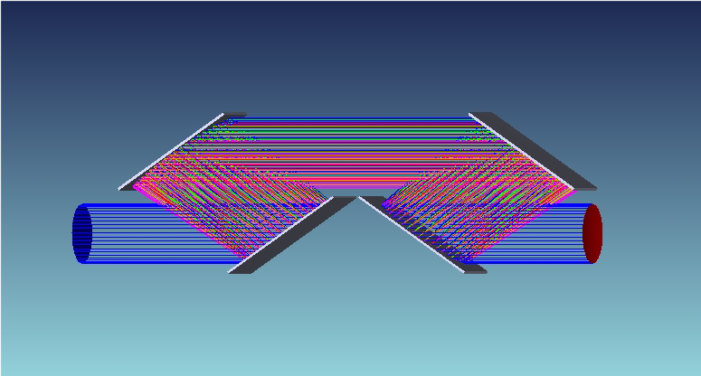
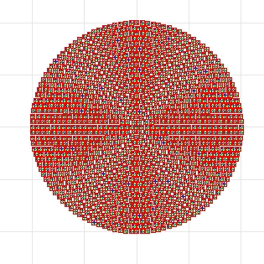
Compressor characteristics
400 mm
Spot diagram at the output of the compressor
x
y
  Four gratings configuration (in line)
  Grating size: 910x455 mm²
  Grating density: 1480 gv/mm
  Angle of incidence: 56°
  Distance between gratings = 950mm / stretching ratio = 13 ps/mm

Slide 16
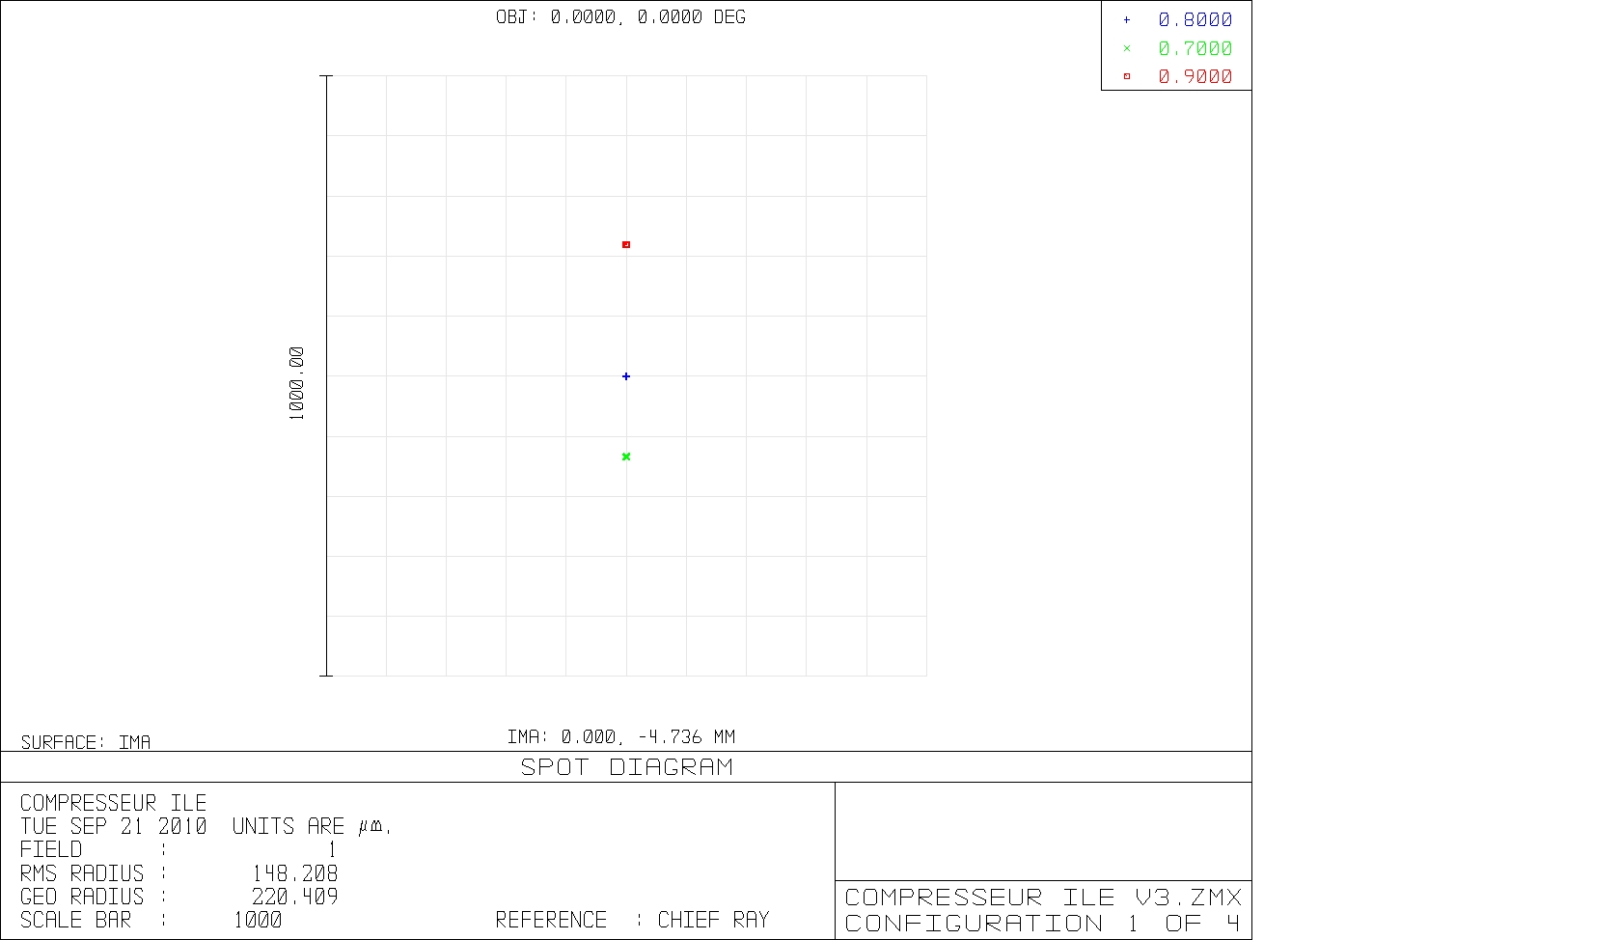
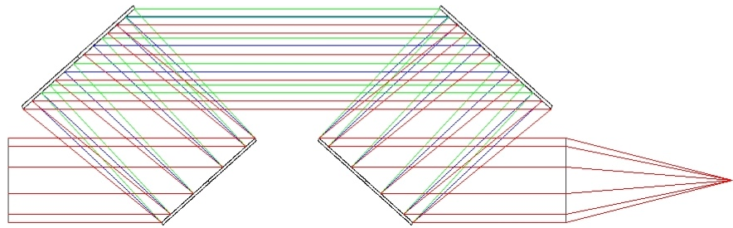
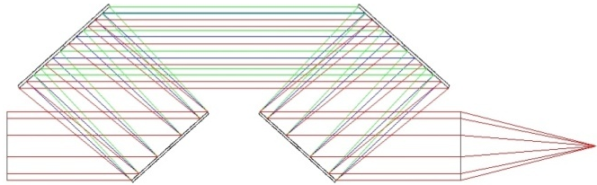
Misalignment study:
X tilt / Z tilt of the 1st grating
Blue = 800 nm
Green = 700 nm
Red = 900 nm
Rotation of the first grating of 0.1° around the x axis (1.7 mrad)
horizontal dispersion of 127µm
Z tilt (parallel to the grating grooves) on the first grating of 0.1° (1.7 mrad)
vertical dispersion of 226µm (Y tilt is twice less):
127 µm
Spot diagram at the output of the compressor, after a perfect focal lens (f1000)
Spot diagram at the output of the compressor, after a perfect focal lens (f1000)
226 µm

Slide 17
Spectral phase management
Study and optimization of the stretcher specifications:
First step : stretcher and compressor gratings have 1480 gv/mm
Compressor charac.:
1480 gv/mm
incidence = 56°
Zc = 950 mm
15 fs

Slide 18
Materials dispersion compensation
System stretcher – amplifiers – compressor with 1480 gv/mm gratings
The amplification chain uses: Calcite, Silicium, Ti:Saph, etc…
Optimized stretcher charac.:
1480 gv/mm
incidence = 56.67°
Zc = 960.57 mm

Slide 19
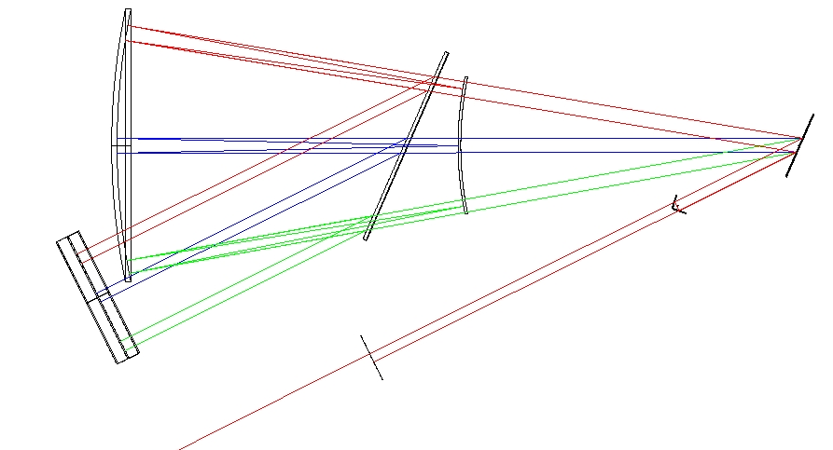
Changing the number of grooves:
compensate the dispersion
Optimized stretcher charac.:
1429 gv/mm
incidence = 50.13°
Zc = 1160 mm

Slide 20
Best compromise: 1450 gv/mm
Optimized stretcher charac.:
1450 gv/mm
incidence = 55.4°
Zc = 974 mm

Slide 21
Phase and duration for a 30 fs input pulse
  The software is now able to suppress the phase along the whole spectrum

Slide 22
Conclusion
By decreasing the number of grooves in the stretcher, we can:
  Manage more dispersive materials in the amplification chain
  Compensate part of material dispersion
The residual phase has to be compensated by a setup like a Dazzler to allow good recompression

Slide 23
Conclusion and perspective
Stretcher and compressor have been dimensioned for a 15 fs pulse
Residual spectral phase still exists but should be actively controled by a Dazzler
  Such pulse duration represents a challenge for the ILE project
To be done:
  Stretcher will be installed in 2011
  Livermore gold gratings will be received in 6 months
  Compressor in 2013
  Collaboration projects to increase the grating damage threshold

Slide 24

Thank you for your attention !

