Slide 1
Dual-Beam Operation of the Astra Gemini Petawatt Ti:Sapphire Laser System
Chris Hooker, Nicola Booth, Oleg Chekhlov, John Collier, Edwin Divall, Klaus Ertel, Peta Foster, Steve Hawkes, Victoria Marshall, David Neely, Bryn Parry, Rajeev Pattathil, Daniel Symes, Yunxin Tang and Brian Wyborn
STFC Rutherford Appleton Laboratory, Central Laser Facility, Chilton, Didcot, OX11 0QX, United Kingdom
chris.hooker@stfc.ac.uk
http://www.clf.rl.ac.uk/Facilities/Astra/12254.aspx

Slide 2
Specification of Astra Gemini
Two independent 800 nm beamlines
15 J per beam, 150 mm diameter
30 femtoseconds pulse duration: 2 x 0.5 PW
Minimum shot interval 20 seconds

Slide 3
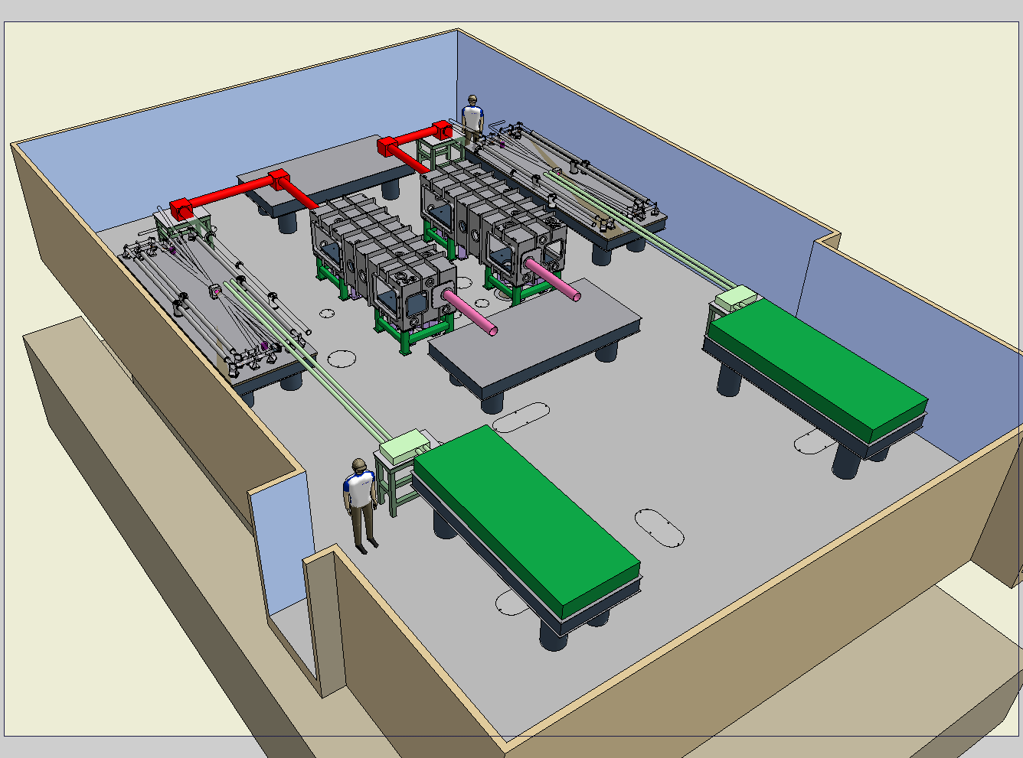
Layout of the Astra Gemini laser hall
Input beam
split & delay
Compressor
vacuum
chamber
4-pass Ti:S
amplifier with
image-relaying
spatial filters
Diagnostics
Pump laser
60 joules
@ 532 nm
in 2 beams
of 45 mmØ

Slide 4
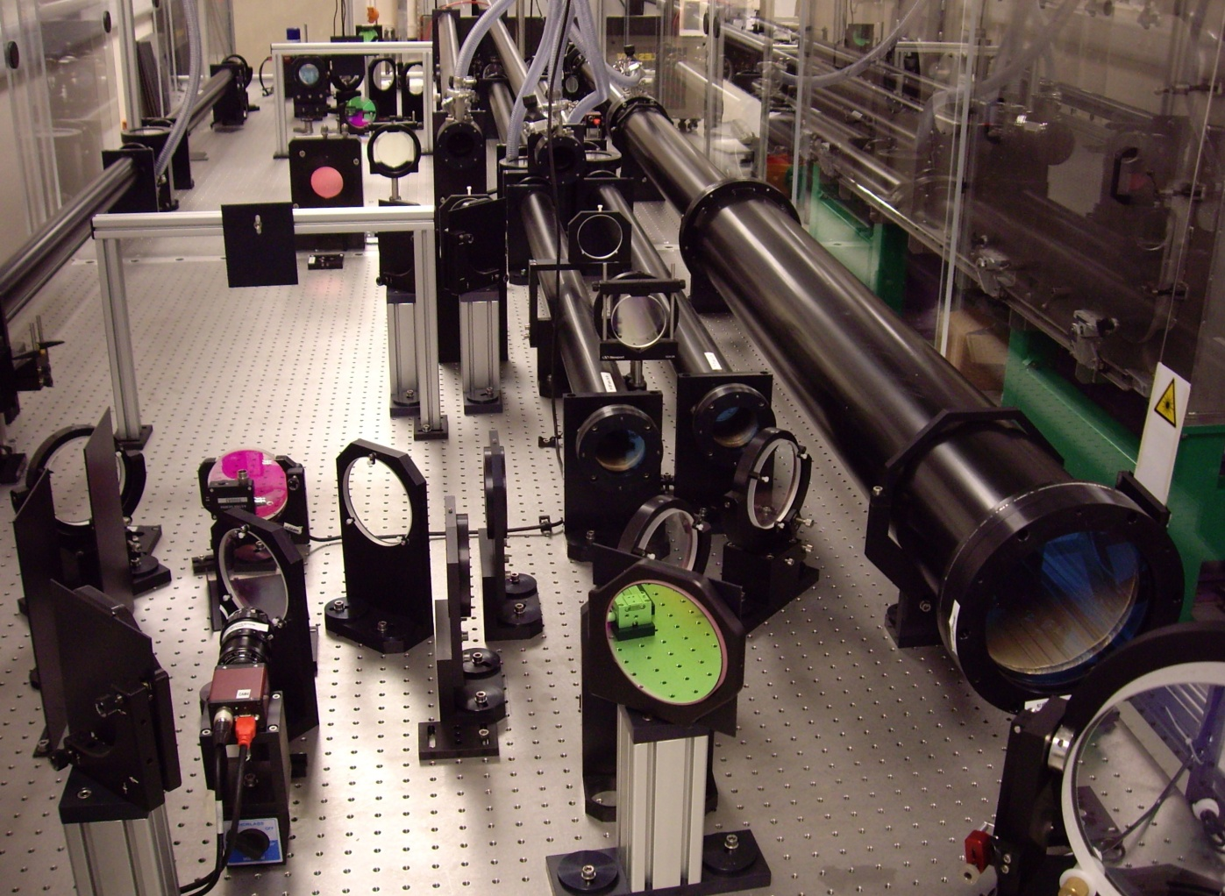
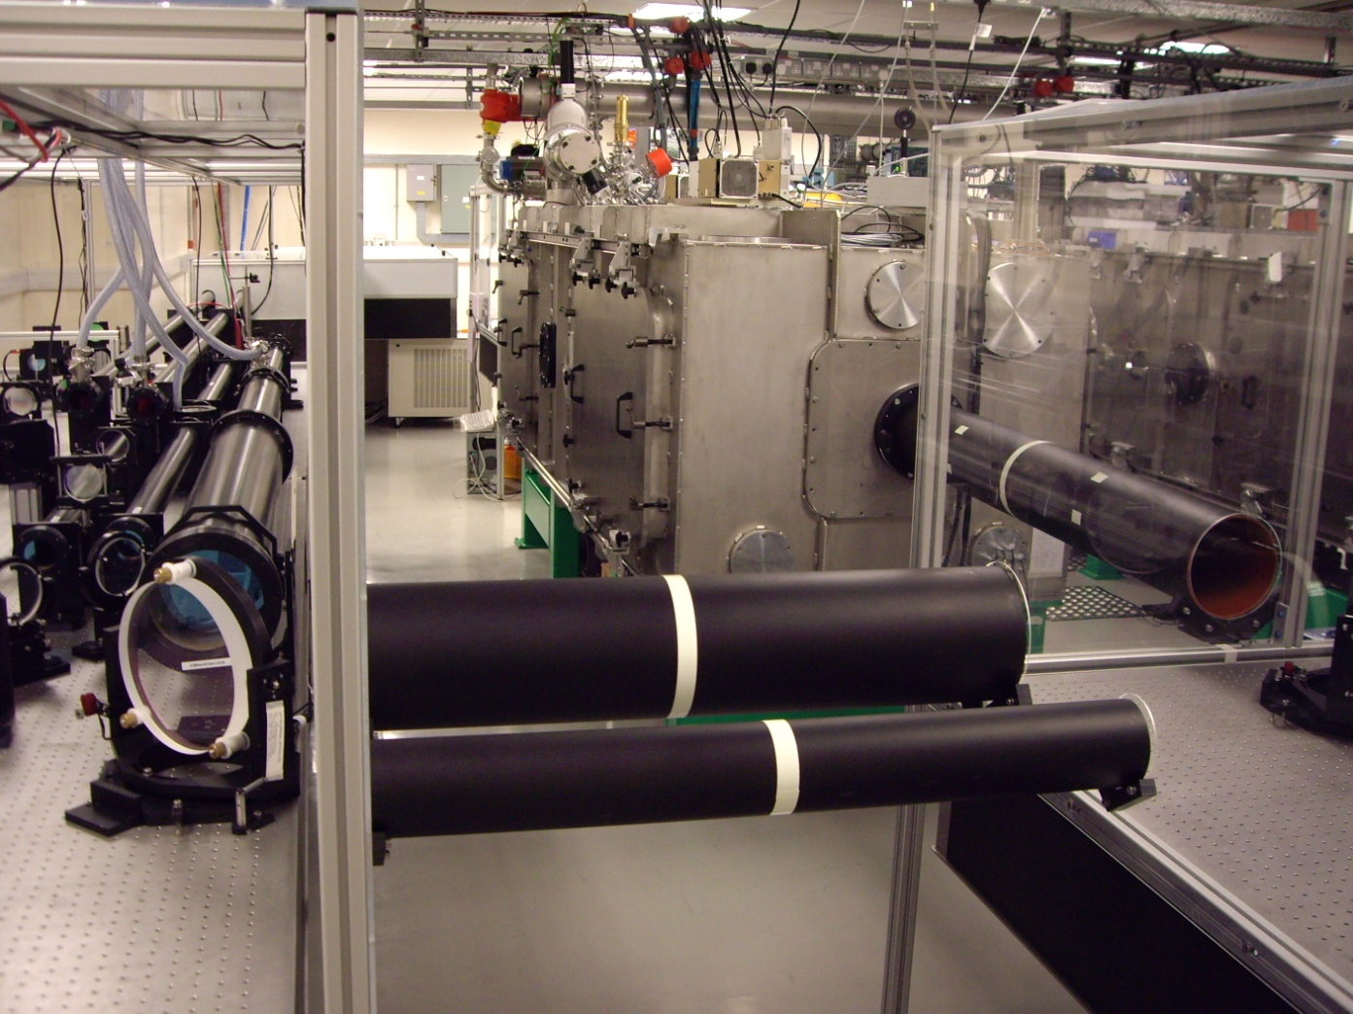
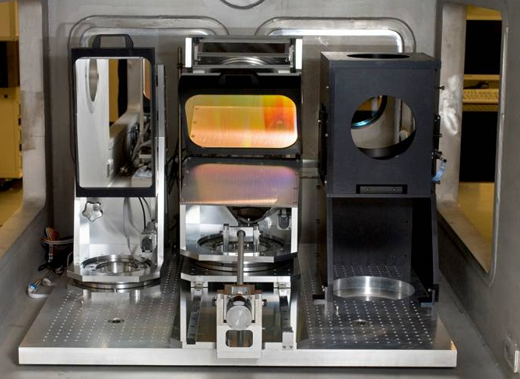
Astra Gemini: second amplifier
Astra Gemini: north compressor chamber

Slide 5
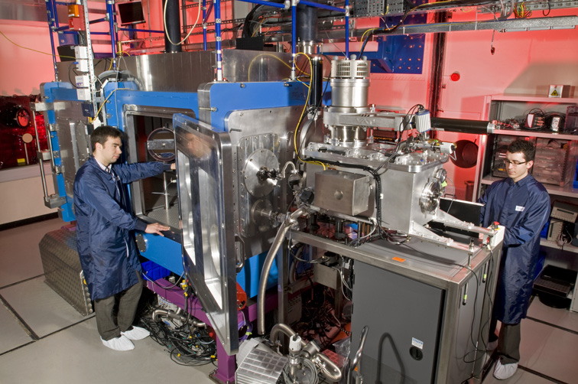
The experimental area is below the laser hall

Slide 6
Dual-beam commissioning issues for Astra Gemini
Amplifier outputs and energy stability
Pulse duration and contrast
Focal spot and pointing stability
Relative timing and spatial overlap of two beams

Slide 7
Long-term energy stability is very good
Output
from
compressor
(Joules)
16 17 18 19 20 21 22 23 00 01 02 03 04 05 06
Time of shot 4th – 5th August 2010
118 shots in total
No operator intervention after 8 p.m.

Slide 8
Pulses have been compressed to ~40 fs
North beam
South beam
GRENOUILLE
traces of the
compressed
pulses
Pulse FWHM = 44 fs
Pulse FWHM = 36 fs

Slide 9
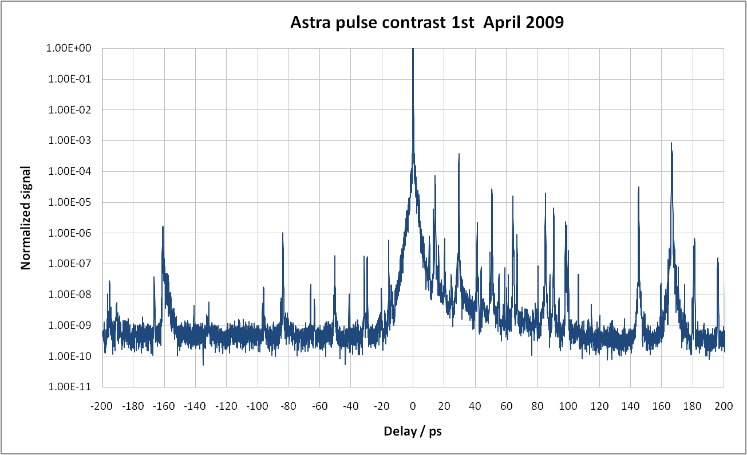
Pulse contrast
Sequoia scan of the Astra 10 Hz beam, April 2010

Slide 10
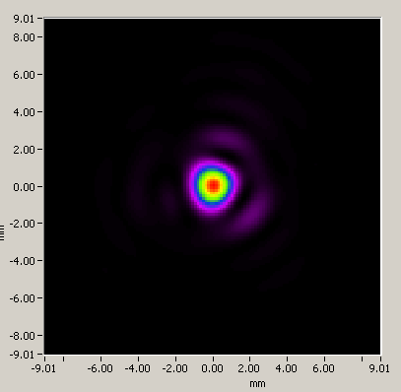
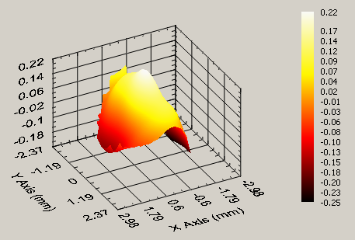
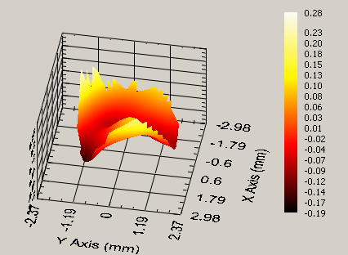
HASO wavefront measurements
North beam P-V = 0.47λ
South beam P-V = 0.44 λ
Reconstructed far field
Far field of 9 Joule shot

Slide 11
Dual-beam timing measurements
Ti:Sapphire North
Split &
Delay
Pump 1
Compressor 1
Diagnostics
Cross-correlator
Compressor 2
Input
Pump 2
Ti:sapphire South
0
metres
5
Total path for each beam is approximately 60 metres

Slide 12
Example of cross-correlator data
Sequence of 274 pulses at 10 Hz showing temporal jitter

Slide 13
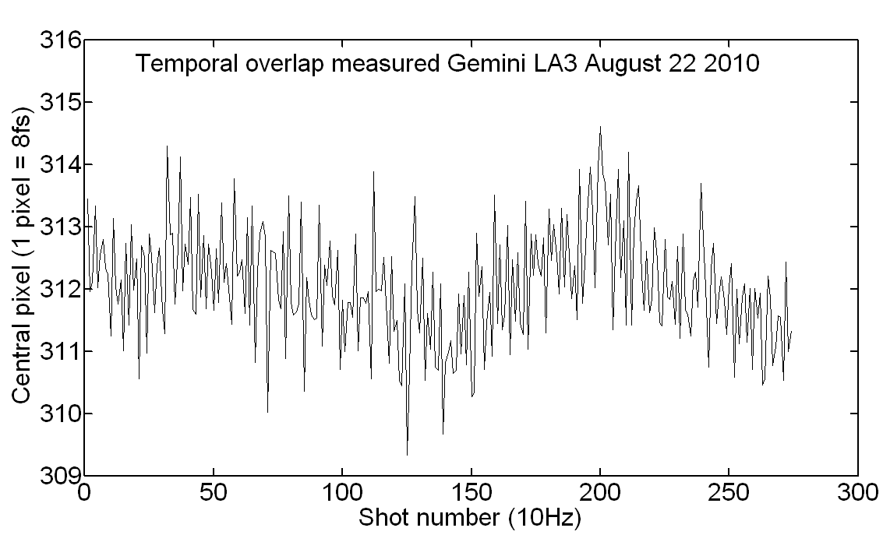
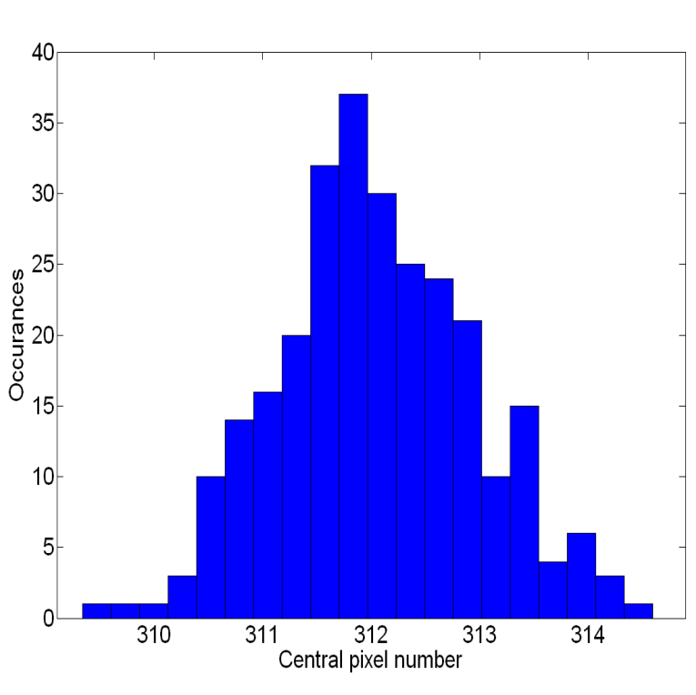
Dual-beam timing results
Temporal scale: 1 pixel = 8 femtoseconds
FWHM of jitter is 16 femtoseconds, i.e ≈ 0.4 T_{pulse}

Slide 14
Dual-beam pointing diagnostic
In target chamber, under vacuum
F/2
F/2
North spot
South spot
Scale 2x2 microns

Slide 15
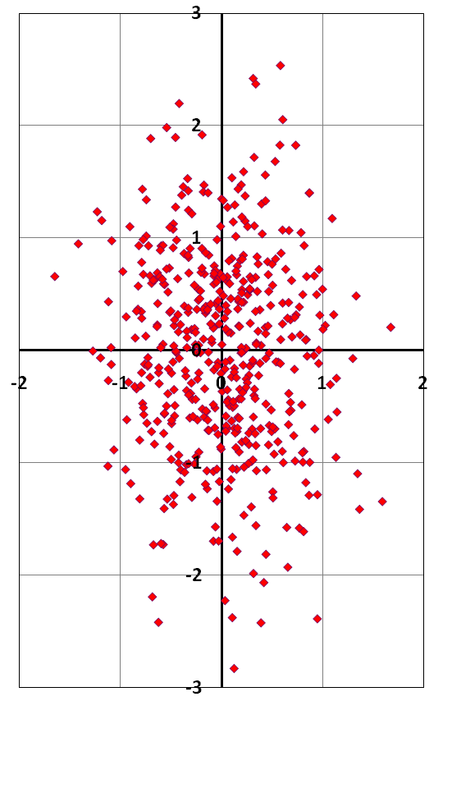
Dual-beam overlap: early results
3
Data obtained using 10 Hz Astra
beam: 500 points plotted
2
FWHM of DL spot ~2 microns
1
72% of shots show a relative
displacement of 1 micron or less
0
Not clear yet why the spot
displacement is asymmetric
-1
-2
-3
-2
-1
0
1
2

Slide 16
The current status of Astra Gemini
Reliably obtain 15 J on target from both amplifiers
Pulse duration currently 40fs (goal is 30fs)
Pulse contrast acceptable for most experiments
Relative timing and mutual overlap of two beams measured
Two F/2-F/20 dual-beam experiments completed
The first full test of Gemini will be in January 2011

Slide 18
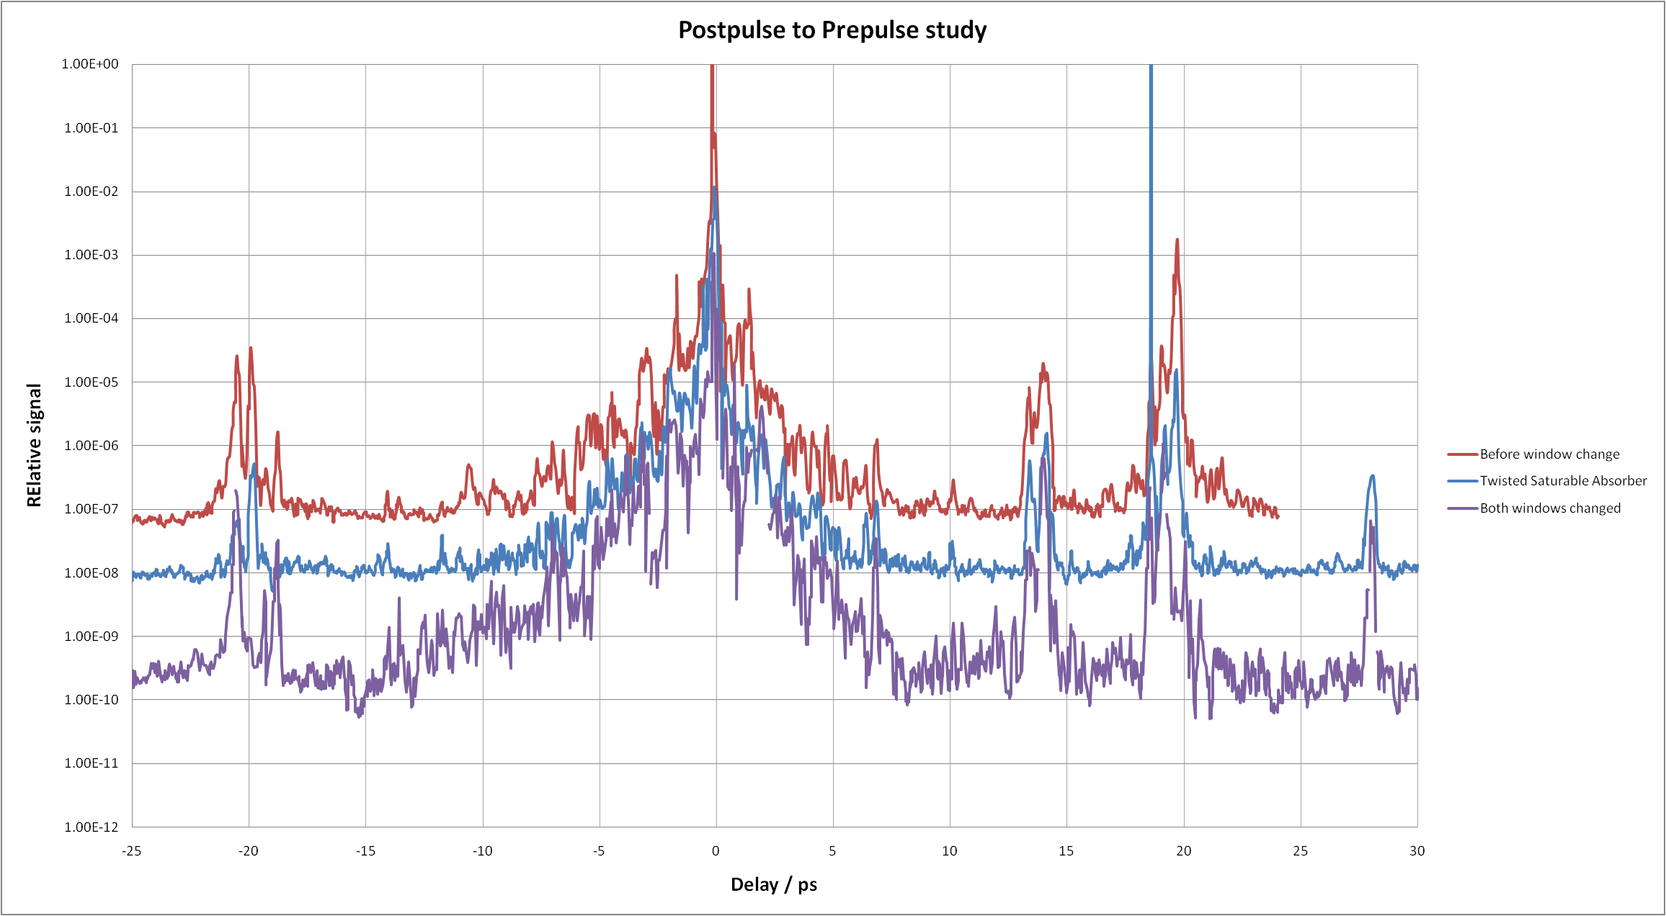

Slide 19
