Slide 1

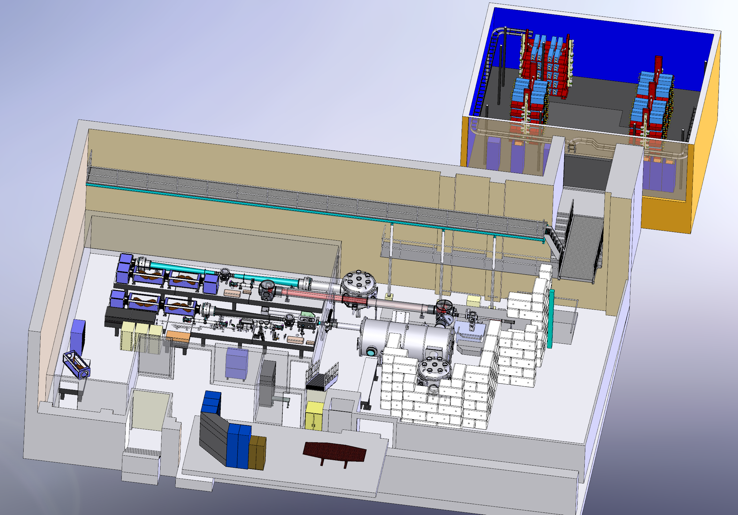
Status of the Texas Petawatt laser and Experiments
Presented at the ICUIL 2010, Watkins Glen, NY
Texas Center for High Intensity Laser Science
The University of Texas at Austin
Erhard Gaul
Texas Center for
High Intensity Laser Science
University of Texas
Mikael Martinez
Ted Borger
Gilliss Dyer
Doug Hammond
Srdjan Marijanovic
Marty Ringuette
Ramiro Escamilla
Franki Aymond
Woosuk Bang
Joel Blakeney
Todd Ditmire
Capacitor room
Petawatt laser
Compressor

Slide 2
Optical Parametric Amplification and mixed glass amplification produces a new type of Petawatt laser
Stretcher
Mode-locked
oscillator
100 fs, (16 nm), 2 nJ
Gain narrowed
spectrum
35 nm
11 nm
broadband
OPCPA
stages
mixed
glass
stages
Gain factor: 10¹⁰ energy gain: 1J
Gain factor: 400 energy gain: 250J
Compressor
200 J, 150 fs
1.3 PW
Goal: > 1 Petawatt

Slide 3






































































The Texas Petawatt laser uses three OPCPA and two Nd:glass amplifier stages
oscillator
ISO
FR
Image inv.
Roof top
FP
PC
Pump 4J
BBO
BBO
Pump 4J
YCOB
RGD lens
FR
Rod
ISO
ISO
Disk Amp

Slide 4
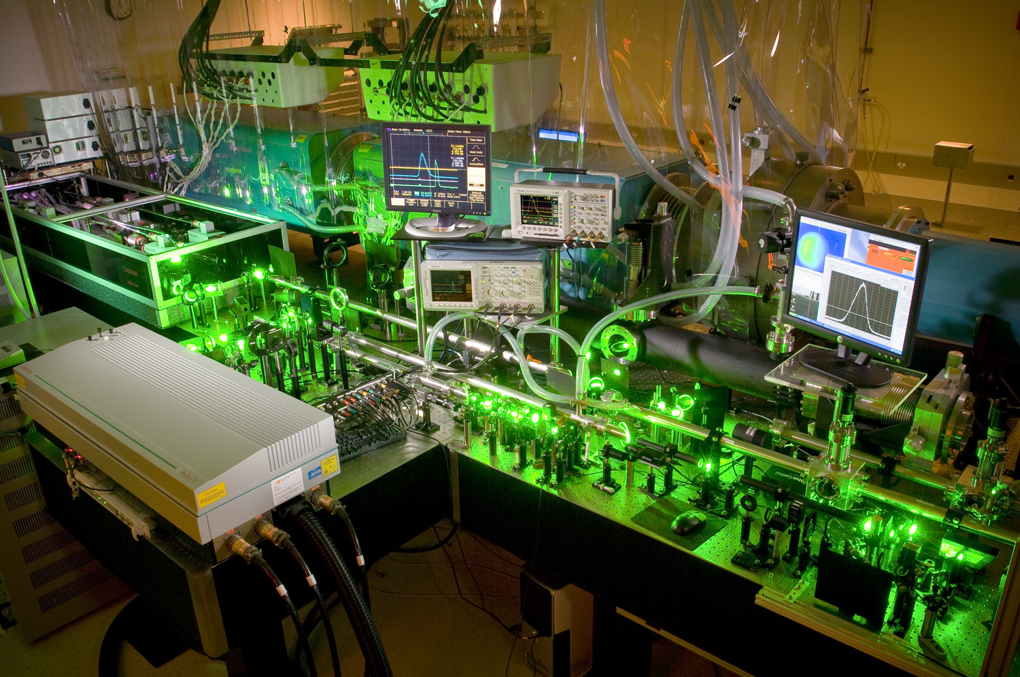
Two pump lasers were used to allow for separate timing between OPCPA stages II and III
4J custom YAG laser
4.0 J
OPCPA
Stage III
200 mJ
OPCPA
Stage I
0.8 J
OPCPA
Stage II

Slide 5


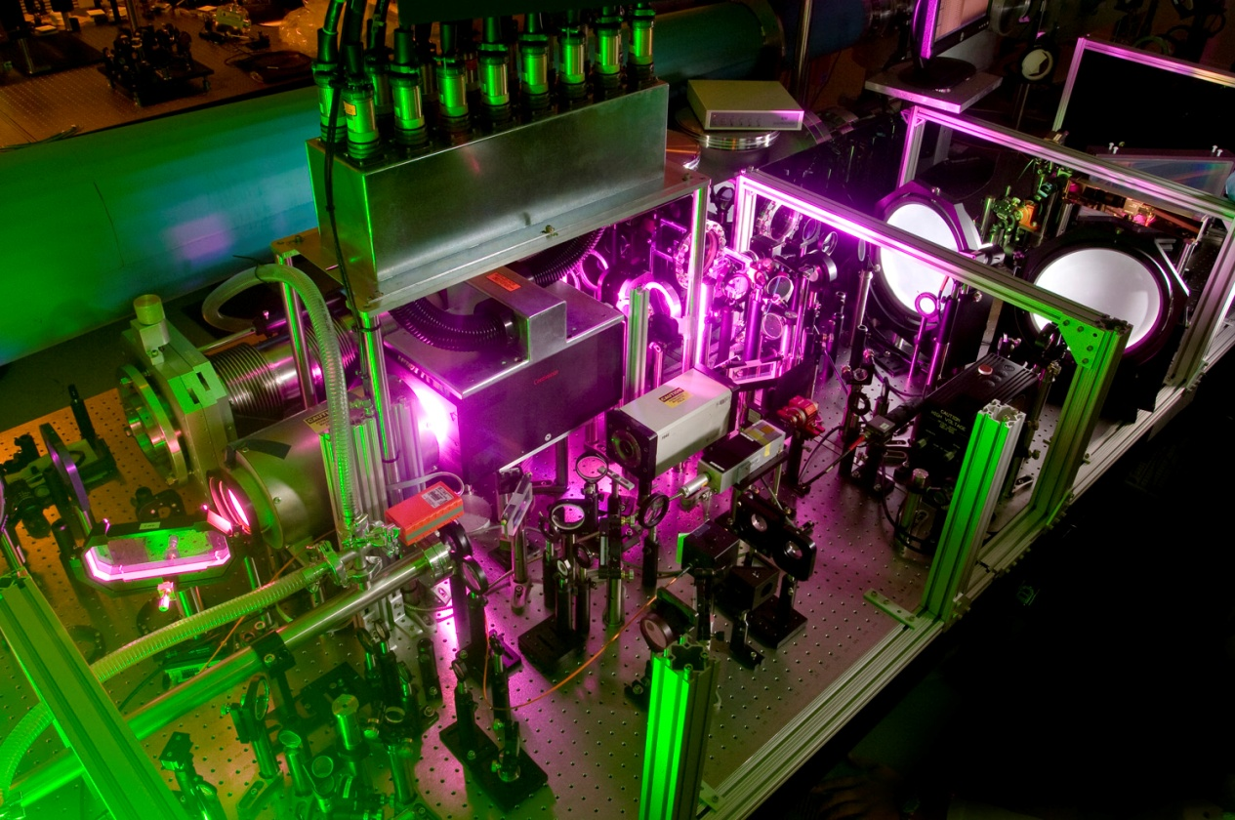
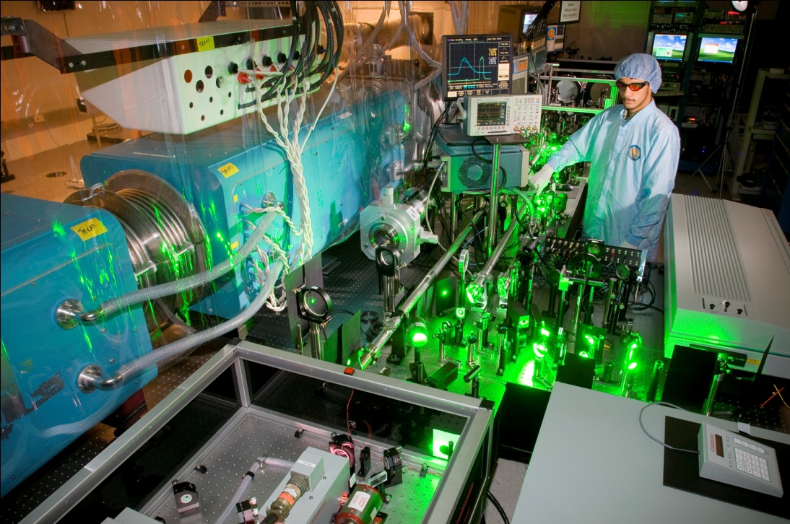
An 8-pass, 64 mm, silicate Nd:glass rod amplifier brings the energy up to 20 J
Radial Group Delay lens
FR
Rod
up to 27 J achieved,
15-18 J goal for compression and low B-integral
Deformable mirror

Slide 6
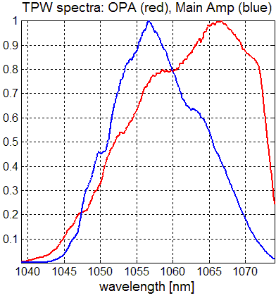

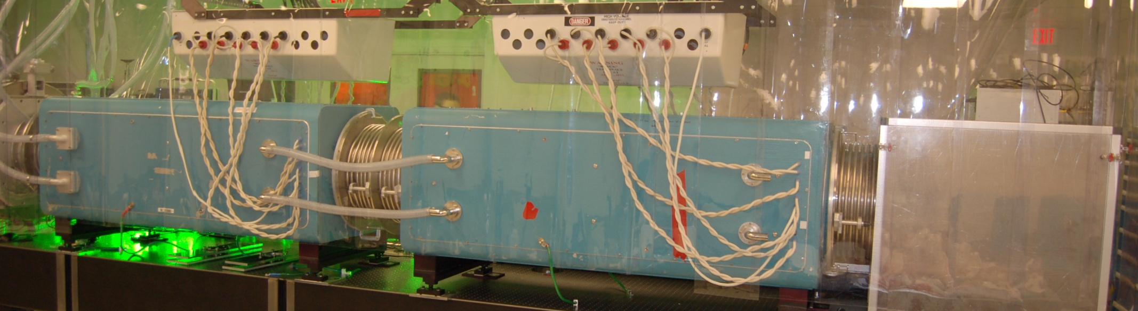
The final amplifier use two Nova amplifiers with phosphate Nd:glass disks
ISO
Disk Amp
14.7 nm
up to 248 J achieved, with 80% charge voltage
Energy limited by gratings, not by gain.

Slide 7
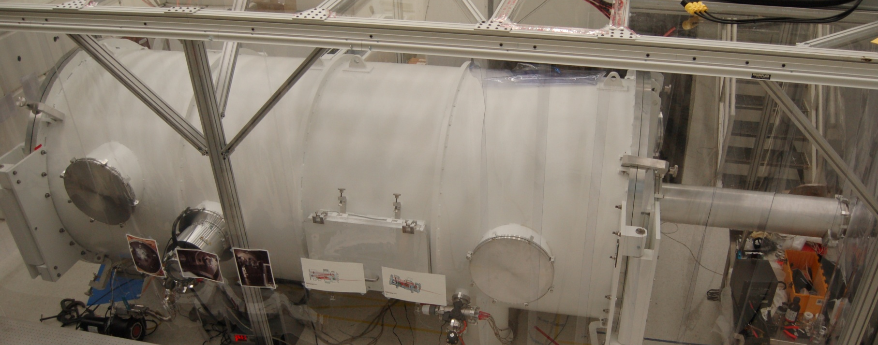
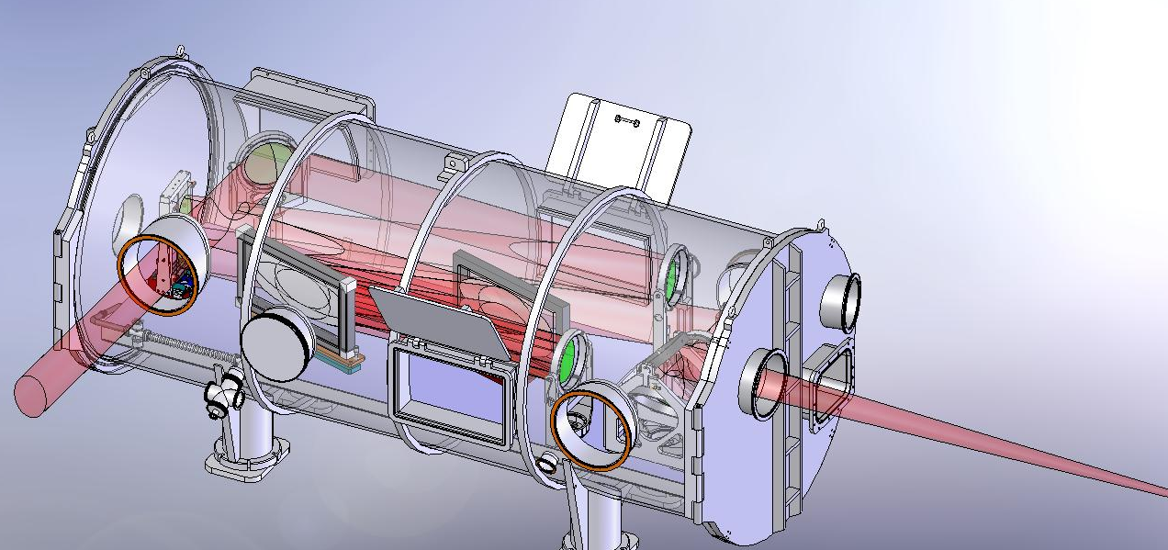
The compressor is inside a 6x14 ft Aluminum vacuum chamber

Slide 8
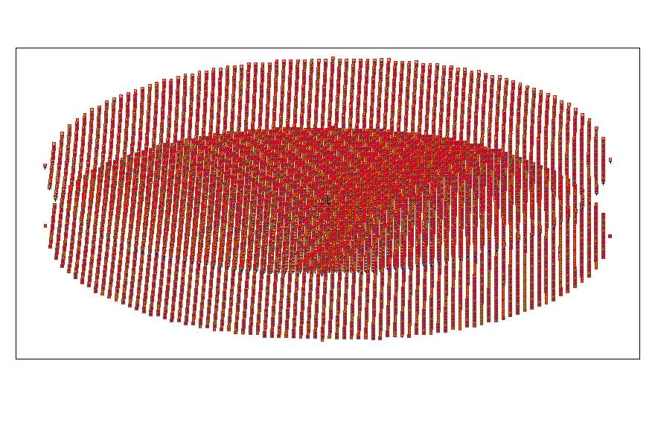
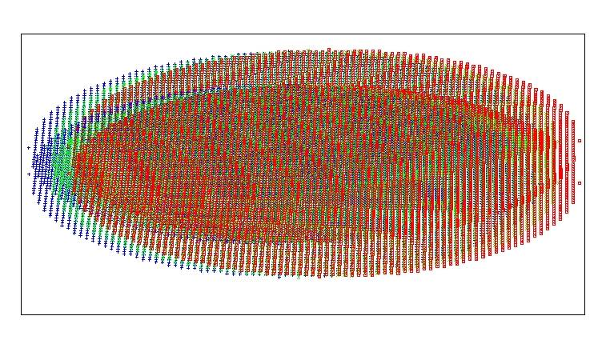
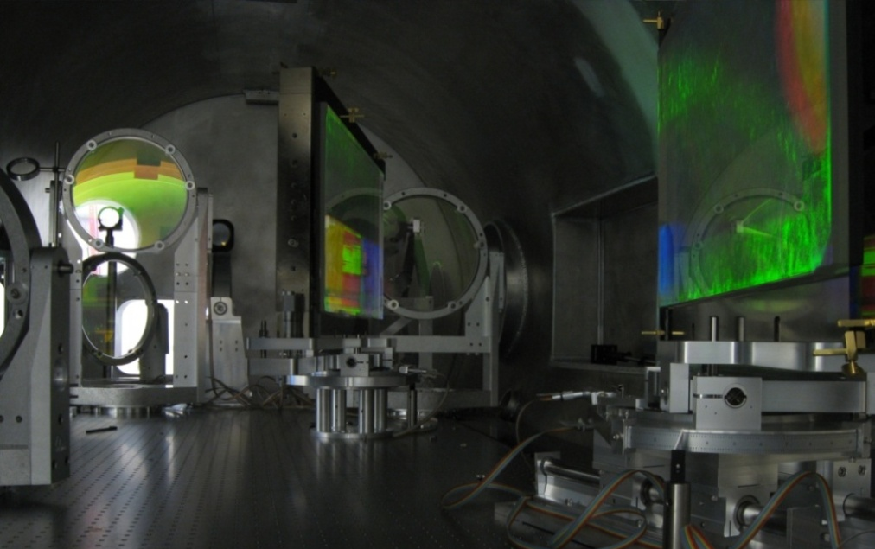
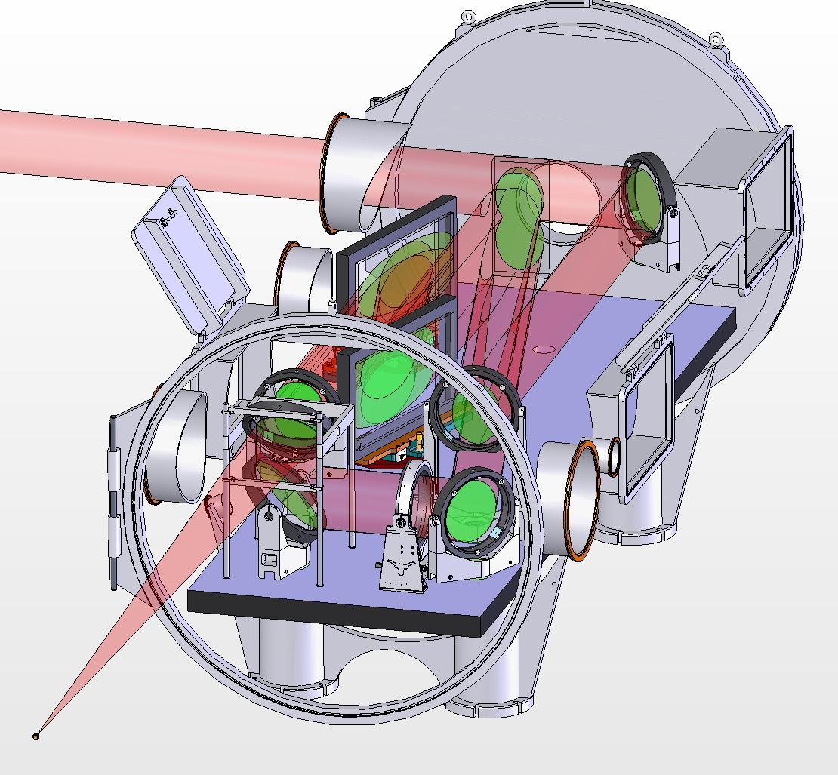
The Compressor has 85% efficiency with MLD (Multi Layer Dielectric) Gratings from LLNL
Grating distance =128 cm;1740 lines/mm
Footprints of beam of both passes overlap partially for efficient use of gratings (405x805 mm² at 1740 l/mm)
1
0.8
0.6
Compressor transmission
0.4
0.2
0
λ = 1050,1057,1064nm
1.02
1.03
1.04
1.05
1.06
1.07
1.08
1.09
wavelength [
μ
m]

Slide 9
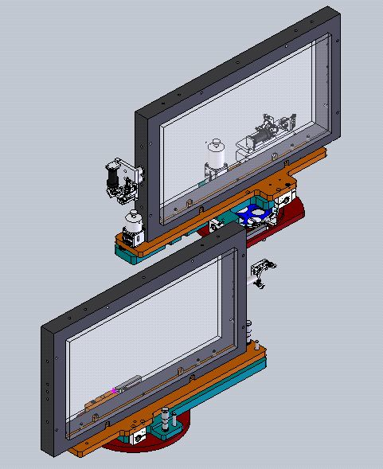
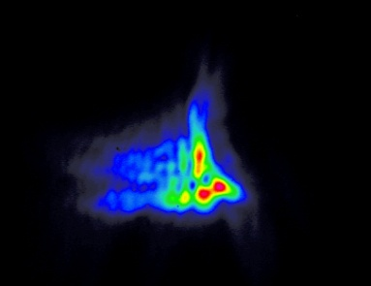
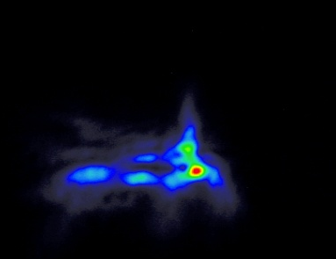
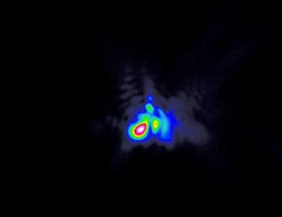
After some time under vacuum the tip and roll parallelism would drift to the point that focusing was affected
Tip
Focal spot (false color)
> 24 hours after compressor pump down
Roll
Rotation
Rotation parallelism only fixed
• High bandwidth + high lines per mm
• Large heavy gratings
• Occurs despite breadboard being isolated from chamber down to feet
Rotation, tip, and roll fixed under vacuum

Slide 10
Grating parallelism has low tolerance but is very important for pulse compression in space and time
Rotation/Tip alignment (multipass with farfield)
Roll/Rotation alignment (multipass of Littrow)
G2
Reference mirrors
G1
[units: arc sec] | Rotat | Tip | Roll
Requirement (for <1 fs error) | 1 | 5 | 10
detection | ~1 | ~3 | ~3
achieved | 1-3 | ~3 | ~3
Step size resolution | 0.05 | .8 | .3
Reproducibility | ~.3 | 2 | 2
Components used to solve issue
• High load motors replaced manual tip/roll
• Reference mirrors
• Two in-vacuum video cameras
• Two fiber lasers

Slide 11
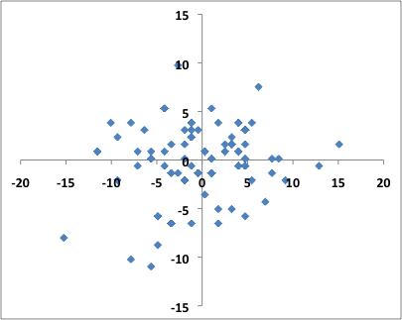
We tracked and eliminated major sources of pointing jitter to achieve RMS pointing stability < 7 µrad
Sources eliminated
• Laser enclosure vs. wind currents
• Mechanical pump isolation
• Improving rigidity of some supports
• Vibration resonances (ongoing)
Current pointing jitter at target
7 µrad RMS horiz
5 µrad RMS vert
Used far-field diagnostics at 7 locations
1) OPA output
µrad
2,3) Rod Amplifier midpoint and output
4,5) Compressor input and output
6) Focusing optic
7) Target

Slide 12
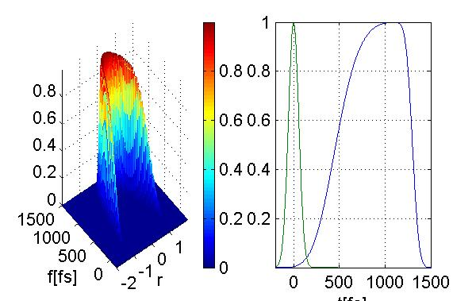
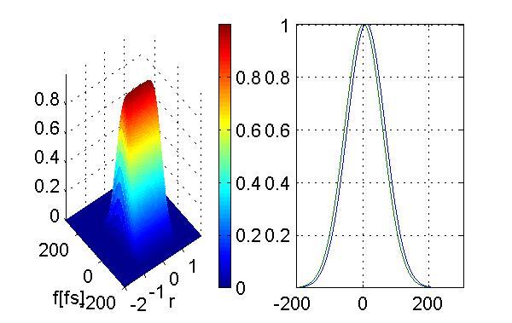
Radial group delay of pulse front caused by large lenses must be corrected
Problem:
Solution requires:
(λ dn/dλ)_{system} = 0
Phase front: v_{phase} = c/n
Phase front is flat for proper imaged system
We have a negative lens/ aspheric mirror to correct this problem and built an special autocorrelator to measure Radial group delay
Pulse front: v_{group} = c/(n-λ dn/dλ )
Pulse front needs correction (φ₁(x,y)=const)
Pulse broadening of 5th order super-Gauss with ~70% fill factor

Slide 13
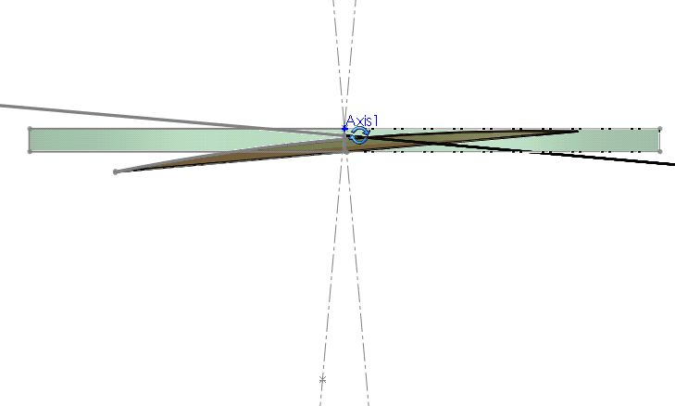
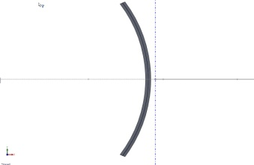
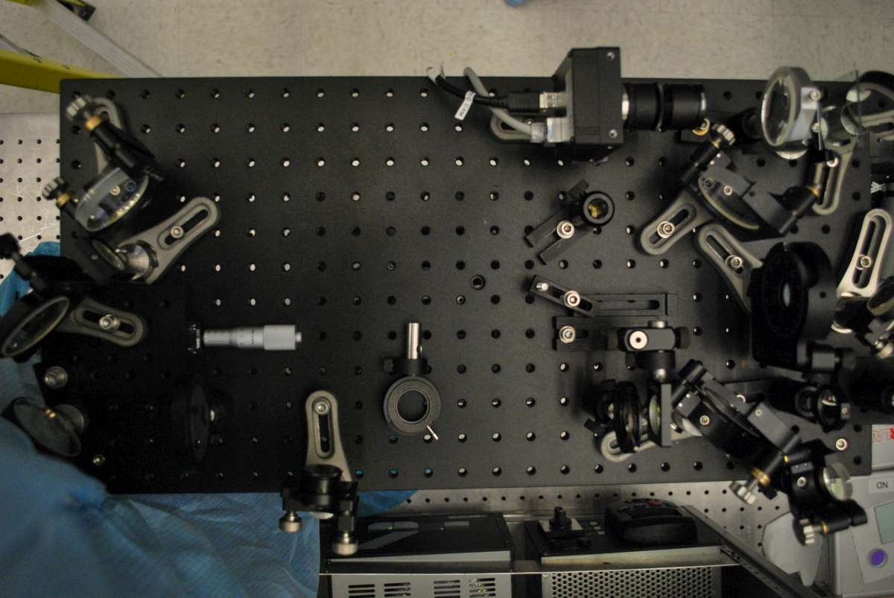
Radial shearing, 2nd order autocorrelation resolves radial group delay across the entire aperture
Upcollimating Telescope
Full “bowl”
Beam Splitter
Expanded, locally flat
Full down-collimated beam input
Crystal
Intersection
Doubling
Crystal
Mixed Signal
Beam Overlap in Crystal
CCD Camera
CCD Camera
Filters
Imaging
2ω Crystal
Expanded Beam
(locally flat)
Beam Splitter
Small Beam (fits on CCD)
An ordinary autocorrelator conceals RGD effects!

Slide 14
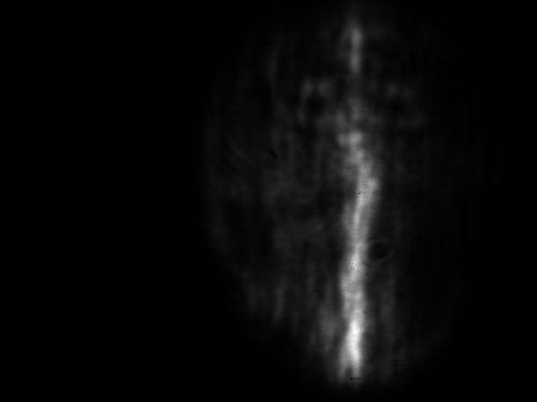
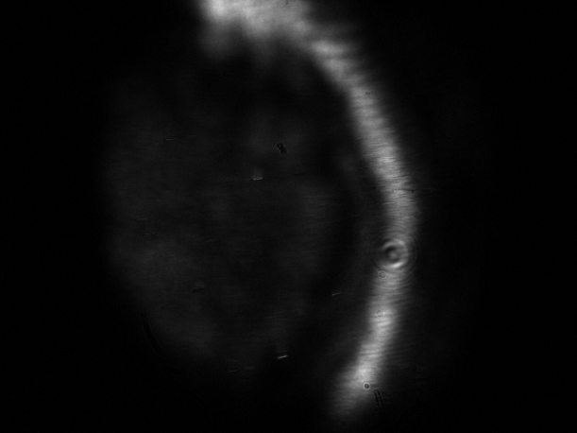
Common autocorrelation techniques do not measure the effects of radial group delay
Standard SHG autocorrelation will measure a narrow temporal overlap across the beam.
Doubling
Crystal
Input
False pulse duration
Imaging CCD detector
150fs FWHM
24cm
3.6ps
SHG correlation between the (full size) pulse and expanded center reference will measure relative temporal delay between beam center and edge.
Doubling
Crystal
1.1ps
Input
120fs FWHM
Imaging CCD detector
24cm
3.6ps
220fs
Up-collimating Telescope
Problem typically arises in >20 TW TiSa lasers and > 100 TW glass lasers or fs microscopy (Bor J.M.Opt. 88), but is sometimes ignored due to incorrect measurement

Slide 15
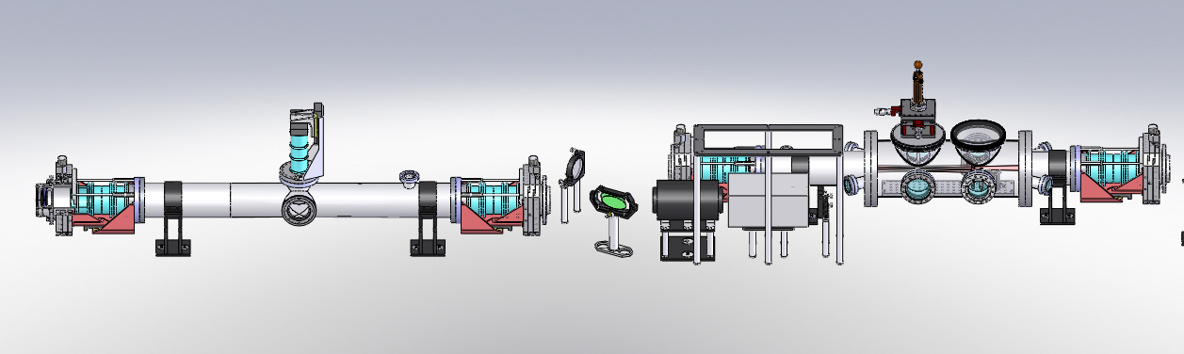
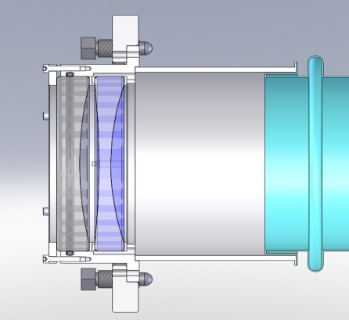
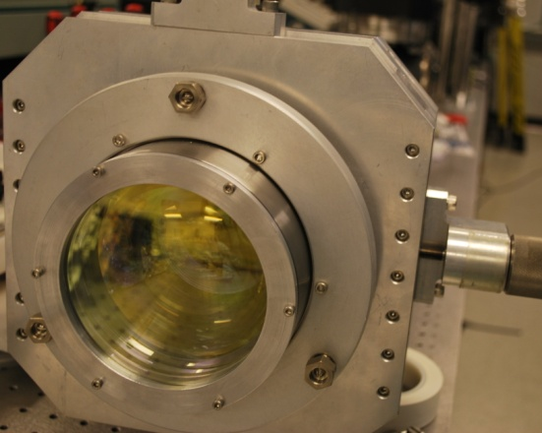
Radial group delay of pulse front can be corrected with achromatic system optics
RGD correction installed in rod amplifier is optimized for all TPW telescopes
The Texas Petawatt 64 mm Rod Amplifier
Rod Amp
Injection Relay Telescope
Faraday Rotator
Output
Relay Telescope
Retro
Input from OPA
corrector lens assembly
Aspheric
Mirror
Negative Lens

Slide 16
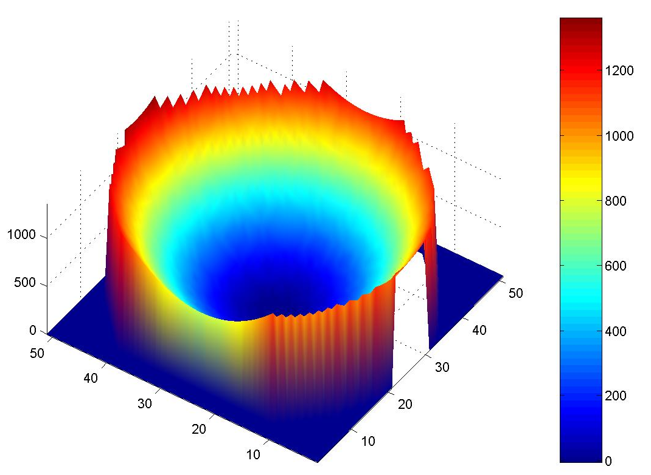
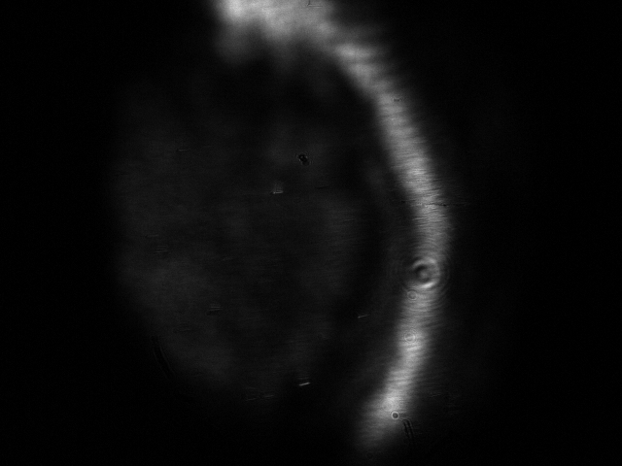
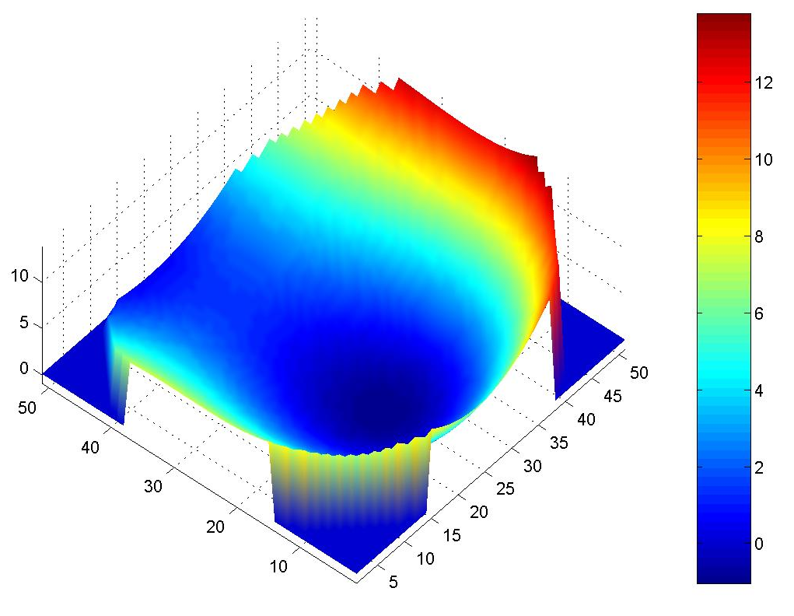
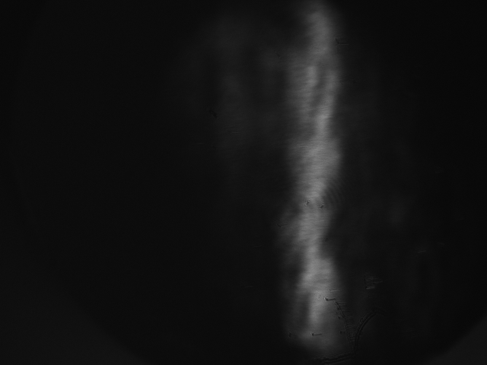
Bulk optics radial group delay correction removes
1.1 ps of spatio-temporal delay
Calculated Radial Group Delay
Uncorrected -> 1.3 ps
Uncorrected Radial Group Delay
1.1ps
Simulation
Time (fs)
Time (fs)
120fs FWHM
24cm
Measurement
Radius (a.u.)
Radius (a.u.)
3.6ps
220fs
Calculated Radial Group Delay
Corrected -> 13 fs
Corrected Radial Group Delay
Time (fs)
Time (fs)
24 cm
< 150fs FWHM
Radius (a.u.)
Radius (a.u.)
2.9 ps

Slide 17
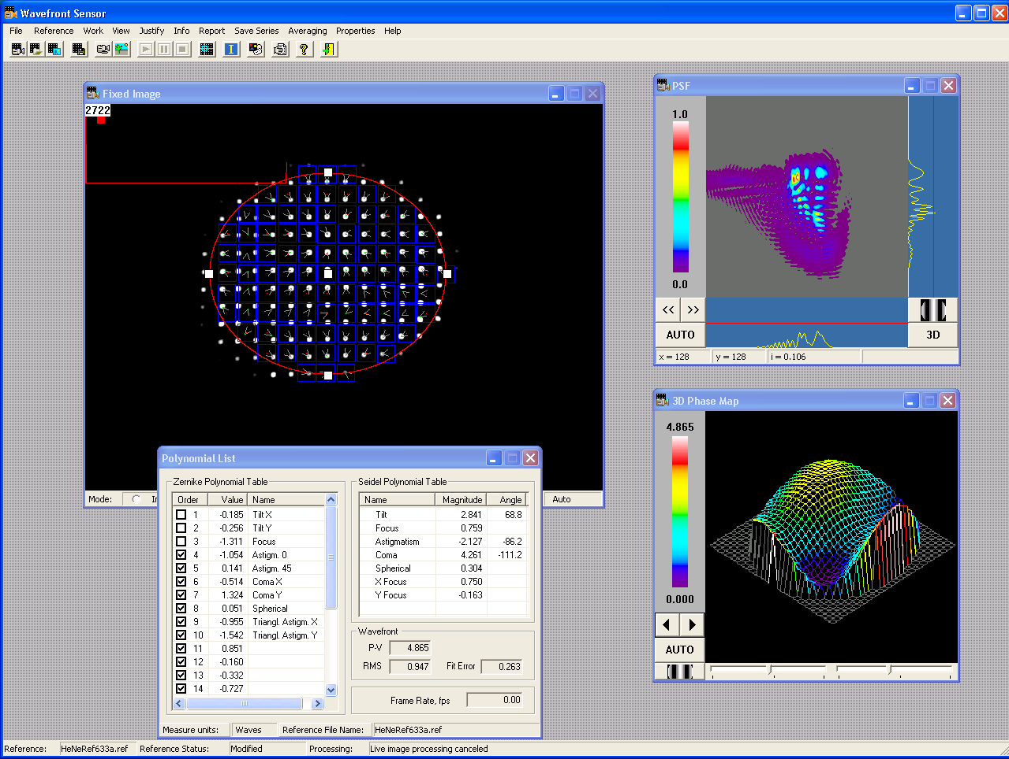
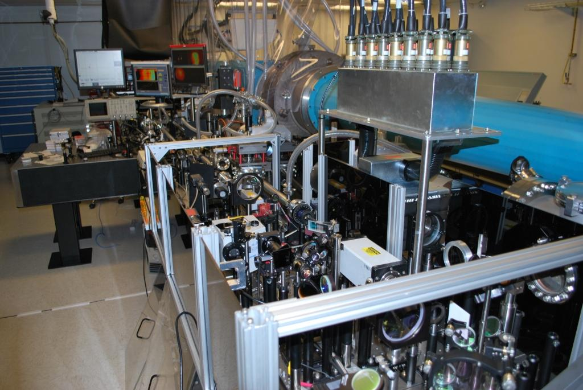
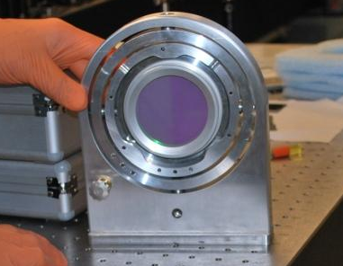
We have installed a deformable mirror to remove and pre-correct measured wavefront distortion
• Wavefront sensor purchased in advance and used throughout system
• Deformable mirror can correct multiple waves of distortion (32 actuators)
• Rod and main amp shots induce thermal distortion
• The deformable mirror is placed at the mid point of the rod amplifier
wavefront sensor control
Location for deformable mirror
The deformable mirror

Slide 18
Pre correction with several iterations are can correct the focus spot but add aberrations abfront
OPA uncorrected
OPA corrected
Rod shot corrected
Comp Input FF
End Chain FF
Rod shot add ~0.75 wave focus during shot

Slide 19
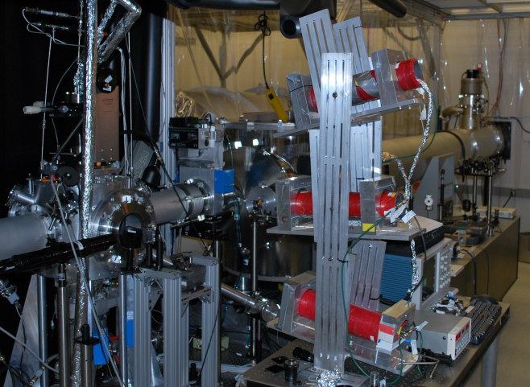
A high f/# beamline enables a variety of experiments more suitable for soft focusing
Laser bay
Leak-through diagnostics
f/40 spherical mirror
Future f/22 focusing option
Cluster fusion setup
Compressor
Full aperture beam pickoff diagnostic
Target chamber at focus
Beam dump

Slide 20
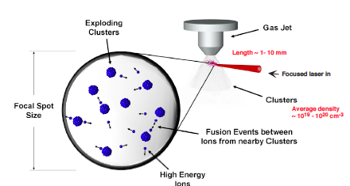
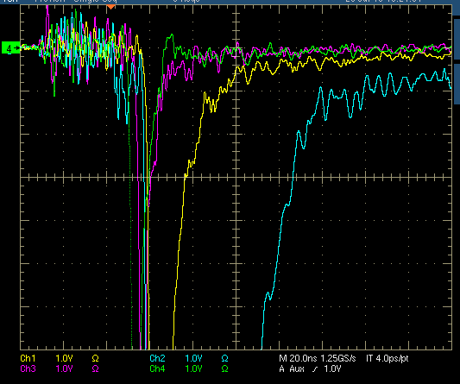
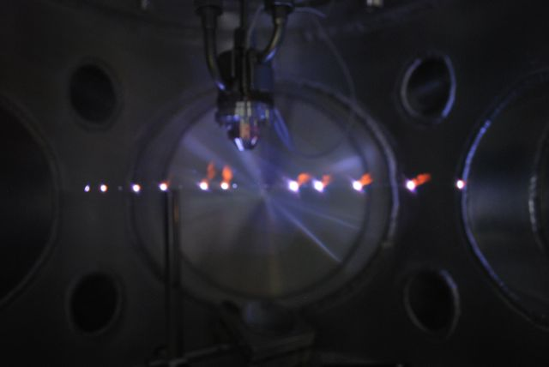
The radial group delay correction enabled the cluster fusion experiment to work properly

Slide 21
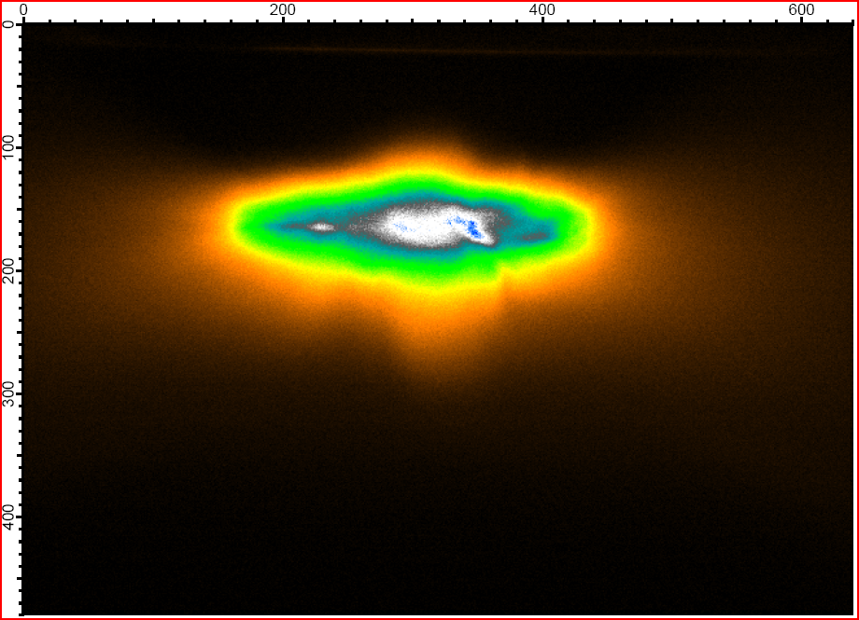
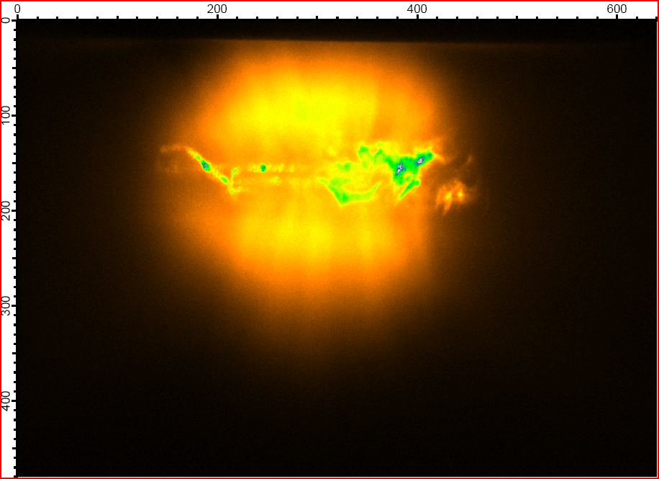
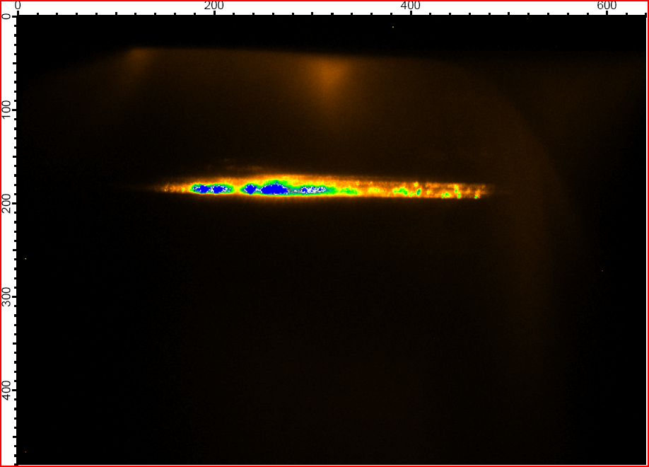
Side image of gas jet shows increasing brightness of the plasma ~3mm below the nozzle
OPA shot 100 mJ
ROD amp shot 10 J
+ OD 2 filter
Gas nozzle edge
Laser input
System shot 188 J
+ OD 3.6 filter

Slide 22
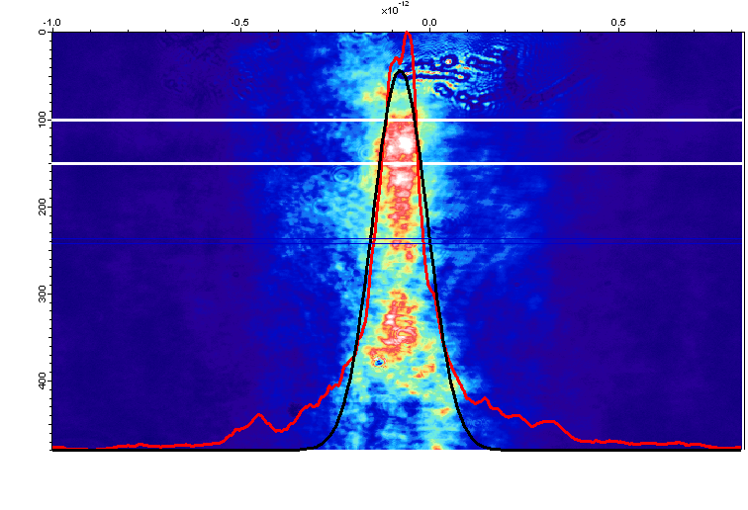
The first series of target shots on CD₄ clusters reached peak powers above 1.3 Petawatt
System shots up to 189.5 J
Rod amp shots
End chain near field image has 65% fill factor
Focal spot has up to 25% Strehl ratio
FWHM = 130 fs
(130-160fs typical)
22cm
diameter

Slide 23
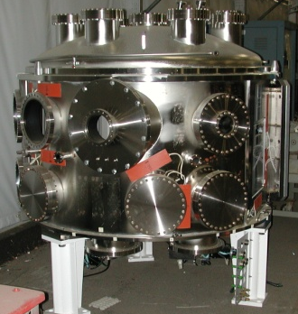
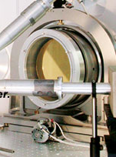
A F#/3 focus target chamber will be added by 12/2010
F/3 focusing target system
Laser bay
chamber
Compressor
F/40 focusing target system
Target chamber
Target bay
Diamond-turned parabola

Slide 24
Alternate silicate glasses improve mixed glass bandwidth
Alternative silicate has broader spectrum and larger separation form phosphate fluorescence peak than standard silicate glass
Key properties are reasonable:
cross section (~70%)
n2 ( x 1.5-2 )
Lifetime long enough
Good thermal prop.
Good mechanical prop.
Good optical properties
S. E.Stokowski, et. al, LLNL-M-95,
Laser Glass Handbook 1981
New glass sample made and tested
Work in progress with SCHOTT for further broad bandwidth glass improvements and manufacturing of mid size rods

Slide 25
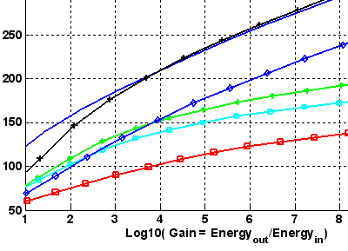
Large gain in mixed glass can sustain bandwidth for <100 fs pulse duration
Pulse duration for various mixed glasses and seed spectrum shaping
Choice for basic seed spectrum shaping
100fs/ 16nm is commercially available
Saturated beam (30 nm super Gaussian
Shaped spectrum
K824 /phosphate mix with modest shaping
Sub 120 fs with gain ~ 10⁷ !

Slide 26
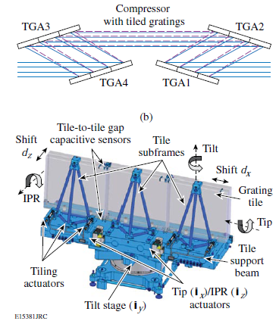
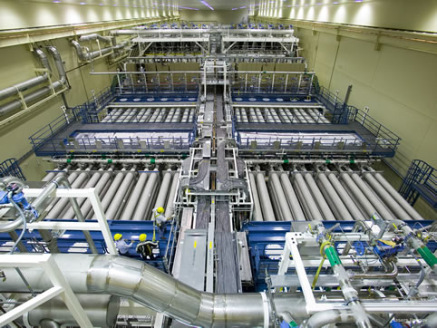
Nd:Glass petawatt lasers have the potential for scalability to multi petawatt lasers
10 PW class laser
2.2 KJ demonstrated at LLE
130 fs demonstrated at UT
Shorter pulses and higher bandwidth possible
1.5 m tiled gratings demonstrated
1.5 m single grating feasible
85 % compressor transmission demonstrated
LLE grating assembly
100 PW class laser
Glass lasers have demonstrated above 26kJ energy in a single beam line
High bandwidth possible
Requires tiling (~3x5) of large gratings
NIF glass laser

Slide 27
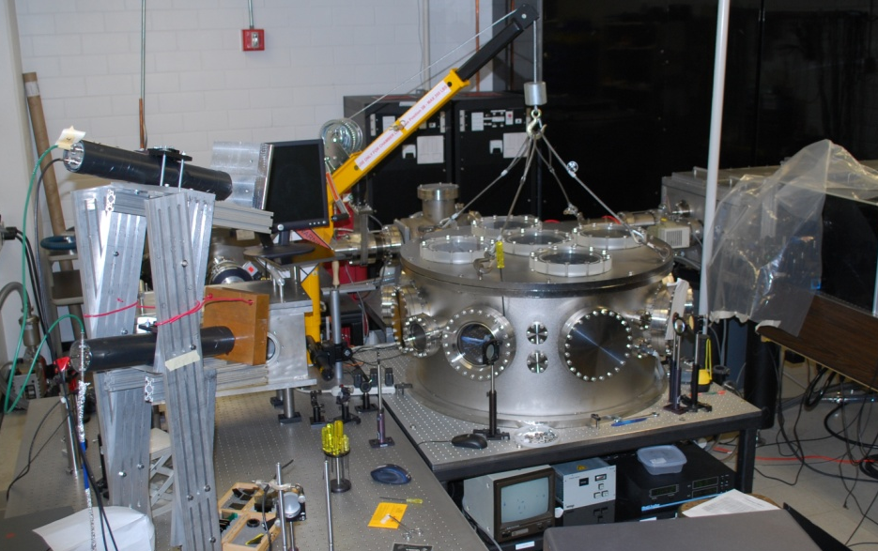
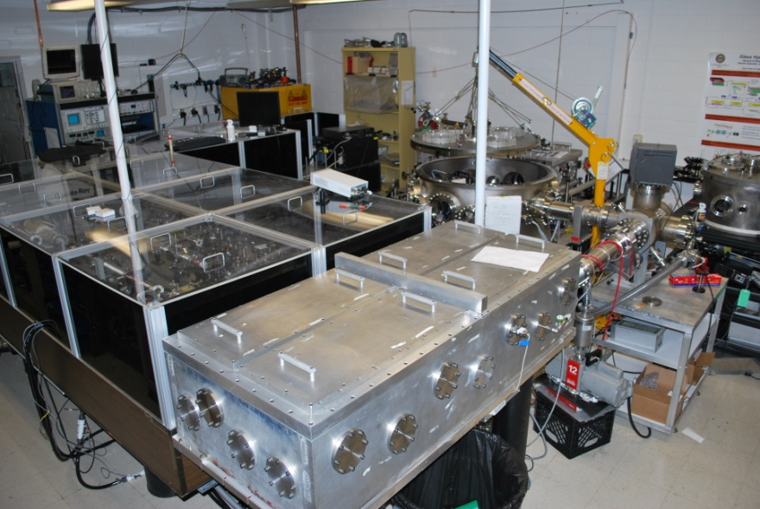
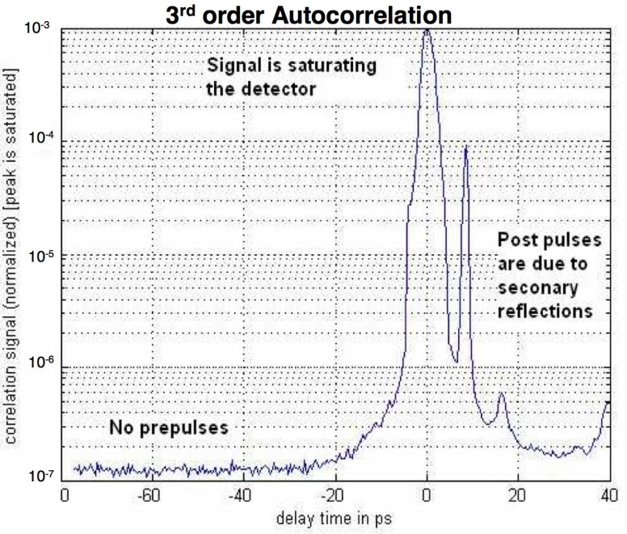
The Glass Hybrid Optical Scaled Testbed (GHOST) laser provides lower energy and higher repetition rate
Mixed glass rod amplified:
  Pulsewidth: 115 fs
  Rate: 1 shot / minute
  Energy: 2 to 3 Joule
OPA only:
  80 fs pulses
  10 Hz / shot on demand
  8 mJ / pulse
Wavelength 1.054 µm
Interaction chamber
Pulse contrast measurements
10⁰
Single shot 3rd order autocorrelation
Intensity
10⁻⁷
GHOST
-80
0
40
Delay (ps)

Slide 28

The THOR laser, our original 30TW target shooter, is being upgraded to a petawatt (30J, 30 fs)
Future layout
Capacitor room
• OPCPA front end
• Additional 10 Hz pump
• New 10 cm Ti:Sapp
• 2x 70 J @ 532 pump
• New compressor
• New target chamber
• New HHG beamline
10 Hz Solid Target Chamber
PW Solid Target
Chamber
Clean room
Target area
Thor Front End
Regen becomes OPA
Compressor
Compressor
Petawatt laser
Final Amp
Radiation shield wall
Glass Laser
XUV Beamline
XUV Inter-action
Control room

Slide 29

Summary
Radial group delay is corrected
Wavefront errors are pre-corrected to a large extend. Strehl ratio up to 0.25 achieved on system shots
Pointing error on target are below 7μrad
We have performed a series of target shot on gas jet targets with over 1.3 PW laser pulses.

